Slide 1
Module 6
Marketing Your Digital Social Innovation – Reaching hearts and minds!

Slide 2
Module 6 Topics Covered
Marketing Your Digital Social Innovation – Reaching Hearts and Minds!
How Storytelling is Critical to Promoting Your Social Innovation Business/Project: How story telling is the perfect way to reach the hearts and minds of your target audiences. How to get people to understand and connect by integrating empathy in your messaging and marketing activities.
Mission Marketing: How your Mission and Storytelling together can help you generate awareness, get support and motivate action and gain support from your target audiences and extended communities
The Power of Storytelling Platforms & Digital Tools: How to communicate and tell your story through different online and offline methods reaching your audiences on a global scale.
Overview
How to use these Modules! These Modules can be adapted, modified, shortened or combined however you think they will work best for you and your students learning. Please respect copyrights, branding and acknowledgement that these resources and materials were developed by Young Digital Social Innovators with the funding and support of the Erasmus+ European Commission.

Slide 3
Module 6 Learning Objectives
Understand the importance and power of authentic story telling and that delivering it across multiple platforms and in different ways will ensure you reach your mission and goals.
Explore how other YDSI’s and global brands have developed amazing stories that connect to the hearts and minds of their audiences and extended audiences
Discover and Learn how to develop your Mission Marketing and Storytelling talents in a cost effective and easy, step by step way so you too can reach global audiences and more importantly get your Mission underway….!

Slide 4
1. The Power of Storytelling to Connect with your Audience
Introduction What is storytelling?
Strategy How can digital Storytelling and Mission Marketing help you tell your social impact to advance your project?
Development What resources and skills do you need to create and share your story?
What do you need to consider when developing a motivating and engaging story?
Tools What technologies are available for curating, storing and sharing your stories?

Slide 5
Marketing to Reach Hearts and Minds Through Storytelling!
Story telling is a powerful tool for inspiring action and change and influencing people.
With the acceleration of digital technology and the world moving quicker than ever and people more connected than ever to stories and information. Storytelling marketing is one of the most powerful ways to communicate impactful digital social innovation projects.
Social innovation stories are the stories people crave to hear, the encouraging positivity of change in the right direction, doing ‘social good’ for everyone concerned and having positive impact on the world leading us into the future are the stories people want to hear.

Slide 6
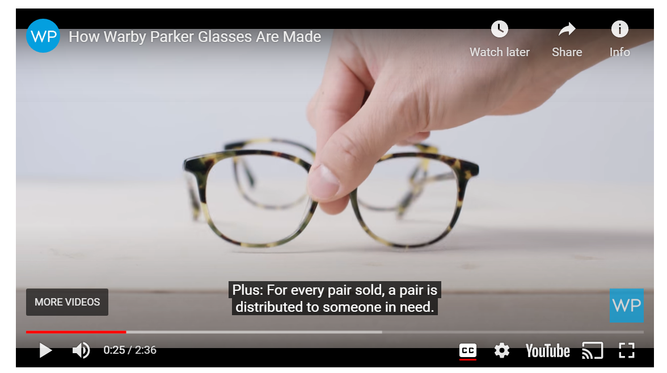
Storytelling Brings Brands and Social Innovation Ideas to Life!
Why is Storytelling Important?
Storytelling is critical especially when you are telling a story about people. Stories are part of who we are. They should describe how your company came about, the reason it exists and where you want to go in the future.
One example of brand storytelling that helps support a company’s product is Warby Parker’s “How Warby Parker Glasses Are Made.” The video follows a pair of glasses from the beginning stages of design to the final stage of production.

Slide 7
The Importance of Storytelling
Stories Help People Connect with You Emotionally!
Great stories inspire people for social cause by creating human connections and emotional vibes with you and what you are trying to do. They will want to join and support you
‘Storytelling allows your audience to get to know you and the ‘social good’ you are doing, by putting a real face, voice and person to the story’
‘Storytelling allows you to connect with people on how something feels in comparison to others. Therefore connecting people through human feeling and emotion’
‘Storytelling is a great way for two completely different people to be able to relate to each other for the first time on the same level’.

Slide 8
How to Tell a Great Story!
‘People don’t buy what you do they buy WHY you do it’
Simon Sinek

Slide 9
‘We won’t act or change or help if we don’t ‘feel’’
‘Statistics don’t make us feel guilty, motivated or passionate it’s the people in stories that drive us to make the world a little better.
We hear these stories and connect, we share these stories so that others can connect too’
Young Digital Social Innovator
Amanda Jayapurna

Slide 10
The Importance of Storytelling
Stories Help People Understand You!
Stories can communicate something complex or difficult to understand in a way that encourages understanding and a meaningful connection!
‘Storytelling is a great way of communicating something complex and difficult in a simple and human way through narration and conversation’
‘Story telling is a great way of communicating something others may not understand in a way that is now understandable, relevant and relatable’
‘Storytelling is a great way to get people to engage and follow you naturally where you are going and where you want to be and want to hear and learn more to follow the story’

Slide 11
The Importance of Storytelling
Stories Help Get Discussions Going Around an Important Topic!
Stories can help to introduce a new social innovation topic in a conversational way and help keep the conversation going by engaging and updating actively
Storytelling has a much longer life span to a news reading or article, they can travel wider and faster than published news. Good news is on demand in todays challenging global environments.
Think of news presenters telling their stories in front of the camera instead of behind it. It is more memorable because they are physically there in real time, using their voice, show emotion and the impact of the story
Think of how people are telling their own stories on social media and how depending on the message and how it is told how it can become a viral story reaching every corner of the globe in hours

Slide 12
What is the Goal of Storytelling?
Learn what brand storytelling is and how to use it to engage your audience into your social innovation journey. Make them become invested, follow and support what you do….

Slide 13
The Importance of Storytelling
Stories Can Connect People to Do Better!
Stories can educate, share how we can do better, learn from each other, learn solutions to a problem, how we can work together…
Tell your story to educate people on what they may not know. Inform them of what they need to know to be able to decide that this is a story worth getting involved in, give them facts, examples, ideas…
Create a story with a need, or solution or benefit. The great thing about social innovation is you are benefiting the vulnerable of the world. Demonstrate through story how with their help your project can ‘do good’ and you can carry out your mission. Give them plenty of ways they can help you because not everyone has time, money, resources but are most likely to have at least one.

Slide 14
How to Tell a Story of Impact!
Storytelling helps you to grow and reach your target audiences so you can increase your impact.
Your story can help mobilize and motivate people to actively support your goal!
Storytelling contributes to telling your social innovation idea and social impact inspiring and engaging people who can contribute ideas, energy and resources to advance your mission.
But story telling must be told in a certain way, with a strong goal, and in a way the audience understand what you are doing and how they can help you achieve it!

Slide 15
The Storytelling Roadmap
Raise Awareness
People need to be made aware of the need and why you are doing it!
Understand the Problem and the Solution
Educate people about the key problems and the potential solutions
Care about the Cause
Encourage people to care about the cause
Feel a Sense of Urgency
Create a sense of urgency and magnitude of the problem
Know how to help
Offer opportunities for people to take action and get engaged

Slide 16
You are On a Mission Marketing Journey!
Your mission is what you want to accomplish. In Social Innovation your Mission is what drives your business and its values. It is the reason for your existence. Your Mission should guide, focus and direct you towards your ultimate destination.
Mission Marketing revolves around your Mission. Mission Marketing and Storytelling together will help you as a small start up business to navigate the complex maze of marketing and maximise exposure, awareness and reaching your your target audiences!

Slide 17
Your Mission is…
What you do? Specifies what you deliver to your customers. This is not about all the different things and actions you do but the results you achieve. What you want to achieve, the impact you make…
How do you do it? Defines the type of digital social innovation you do. How you explain the types of products and services you sell and deliver to your customers. Explain this in simple terms. Speak about it like the person has no idea or never heard of you before
Who do we do it for? Identifies the target market that is most likely to buy or need your social innovation products or services.

Slide 18
Create Your Strategy
Your Strategy is Your Storytelling Plan
Identify a Clear Goal and Message
Identify Your Target Audience
Who exactly are you talking to? In digital social innovation this can consist of two different groups
Those you need to support your social innovation. The people you want to support you and help your ‘social mission’ by either donating, talking about it, volunteering…?
Those who need your social innovation. The people who need your mission to help alleviate their problems or challenges or those who can help provide them with a solution using your mission?
What is the most important thing you want people to know about you, what you are doing and why you are doing it?
What exactly is the most important message or story you want to say depending on where you are going to say it (60 words, 140 characters, 300 words…). That way you can deliver it on different platforms e.g. for Facebook posts its good to keep your post to 60 words, Twitter 140 characters and in conversation approx. 300 words.

Slide 19
Create Your Strategy
Your Strategy is Your Storytelling Plan
Set Your Objectives
Set your goals, what do you want to achieve? How do you want others to help you? How you want them to get involved? Think of why you are doing this.
A good place to start is having a clear template writing down answers to the following questions….
What exactly is your mission? Clearly write this down in a clear concise way what your mission is and what you intend to do, in less than 200 words. Get somebody who knows nothing about your mission already to read it and see if they understand exactly what you are doing and intend to do
Why you are doing this?.....What is the purpose of your project? Who is it for? Why are you doing this for them? Why do vulnerable people need it? Why do you think it is important people know about it i.e. those who you need support from and those who are ‘in need’ of your project?
What is the purpose of your story message?....Do you want to educate both your supporters and recipients so they understand better? Do you want to get help with funding, resources or help share your story?

Slide 20
Create Your Strategy
Your Strategy is Your Storytelling Plan
Set Your Objectives
‘Supporters are inspired to spread the word and engage others’
How will I keep my story real, relevant and relate to my target audiences?...How can I get the people in need to understand how I can help them? How can I get those I need to support me to understand what I am doing is important? How can I communicate to supporters that people are suffering and need help and why they need my help? How can I come across honest and real and make sure they want to hear my story and mission?
How will I motivate them?...How will I make sure my supporters want to help me? What will make sure they connect on an emotional and empathetic level? What do my supporters need to hear about my story that makes them follow me, donate, give their time, engage with my social media?
How will I ask them for help?...Funding (Will I add a ‘donation’ button or link to my social media post? Will I set up a Crowdfunding page?) Social Media or Business Support (Will I directly ask them to share my story on their social media channels? Will I put up a post or video dedicated to asking for a mentor or professional business development help?). Offer plenty of opportunities for action on all activities donate, click and read, send a direct message, sign my petition…

Slide 21
2. Mission Marketing and Storytelling
Creating and Developing Your Mission, Purpose…
Mission, Purpose, Goals ,
Messages, Knowing Your Target Audience (their motivations), Your Story, Recipients Stories, Your Key Messages You Need to Delivery
Action and Delivery of Your Stories and Messages
Delivery of Your Storytelling to Generate Awareness and Support
Websites, Social Media, Interviews, Videos, Blogs….
Mission Marketing & Storytelling
Sweet Spot

Slide 22
9 Mission Marketing Storytelling Strategies
Highlight their challenges
Show understanding
Support their beliefs
Honour their values
Turn up the emotions
Use detail generously
Help move them through the different stages
Celebrate successes
Story sharing

Slide 23
Exercise – Developing Your Mission
When it comes to your social innovation business or project it is important to think about it in its simplest form. In the previous Modules you have identified the need or issue. You have looked at how you can address it and you have recognised the what difference you could make to peoples lives.
The following exercise is designed to explore your idea from a few different angles and establish if there are any gaps in what you want to achieve as well as identifying what knowledge you already have.

Slide 24
Exercise – Developing Your Mission
Write down a Mission Statement that says
What are you going to do?____________
Who is going to do it?________________
How it will be achieved?______________

Slide 25
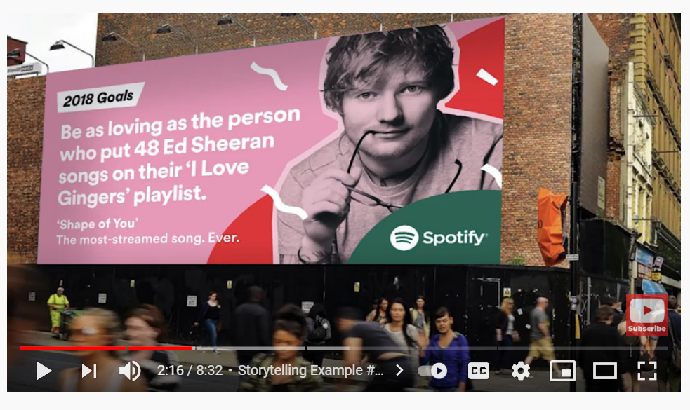
5 Examples of Captivating Storytelling
Learn how brands use story to connect and resonate with these 5 captivating brand storytelling examples.
Spotify
Air B&B
Warby Parker
Dove
Nike

Slide 26
How Storytelling Can Help You!!
Storytelling & Mission Marketing Strategy
People will want to join your journey and become a lifelong supporter or volunteer…
People will want to help you by donating or fundraising…
How can digital storytelling help you tell your social impact to advance your project?
People will follow, share, talk about you, spread the word…
People will want to help you by mentoring or funding…

Slide 27
What You Need to Develop Your Story!!
Storytelling Development
Show as well as tell. You need to back your story up with images, graphics, videos…
Make sure it is conversational and structured. That it has a beginning, middle and end.
You Tube, Social Media or Website
What you need to consider when developing a motivating and engaging story?
Get Your Audience’s Attention and Keep It! Give them more stories and info in different formats. Talk about your successes and how their contributions have helped!
Go behind the scenes! Show what is on the inside. Highlight the people involved, their struggles, your passions..

Slide 28
You Are All You Need To Tell a Great Story!
You & Co-Creation
The best and most meaningful stories come from people with authentic, real and insightful experiences to share
Note: you don’t have to be skilled or trained to be a good storyteller
You just have to be real, show your passion, believe strongly in what you are doing. Get close to the ground and speak the truth. Recognise that you are speaking on behalf of people who need your idea and will most likely not have the opportunity to speak for themselves.
Co-creation means you work with the people supporting those on the grounds and the vulnerable recipients themselves. They should help you to tell you their story with yours combined. This makes a story much deeper, richer with better perspectives.

Slide 29
Storytelling Capacity
Resources, platforms and approaches you need to consider to create and share your story!
Keep Your Story Personal!
Your personal story is the “why” behind your company or brand – the passion, interests and experiences that led to the company’s creation. Always tell the truth – your audience will smell fake news from a mile away, turning them off immediately. Genuine, authentic stories are the ones that really hit home on a personal level.
Have a Website!
So visitors, followers and supporters can navigate through pages with information about you, your mission and why you are doing your project which will create impact for an engaging experience and encourage them to want to follow, support and talk about you…Consider WordPress or Wix both affordable and easy to develop website options.

Slide 30
About Us Section
Is needed to tell the project bio or idea or story focusing on what your company actually does for its consumers and how it does it. You won’t engage audiences with self-centered praise for you and your company alone. Instead, tell consumers how your company and brand can positively influence their lives and others. That way, they’re learning about your brand through the context of how it relates to them and the vulnerable people they care about…
Get Creative!!!
Keep things fresh, relevant and interesting by using and mixing up different media, like moving images, image collages or a live documentary style video, tell your story through TikTok, podcasts or a dedicated gallery section in your website. This will make sure your viewers get engaged and stay interested. (Note: it doesn’t have to be perfect but it does have to be well executed and professional)
Storytelling Capacity
Resources, platforms and approaches you need to consider to create and share your story!

Slide 31
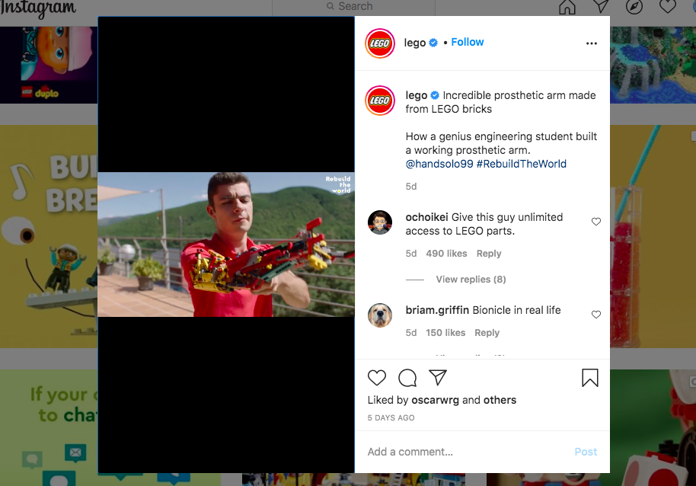
Get Creative: Lego Tell a Great Story!
Aguilar was able to do his first push-up with the prosthetic, and sharing his story is certain to help inspire and motivate others to achieve as he did. It’s also a testament to the empowerment that LEGO can provide to its users, who can do anything they want with the brand’s product. Their wildest dreams aren’t so far away when they can see others make working prosthetics and other functional creations with a few plastic bricks.
Get Creative!
See How Lego Tell a Great Story!
David Aguilar, who built a prosthetic arm with LEGOs, combining engineering, ingenuity and a toy.
Watch Video

Slide 32
YDSI DayCape App Uses Animation to Explain App
Digital Tools Facilitating Children with Autism
Anton Håkanson, DayCape, Sweden
DayCape is a digital image calendar that supports children and their carers and educators in managing their daily schedule and facilitating their lives at home and in school. The underlying philosophy is to uplift their uniqueness and skills and transform autism into a superpower
Anton Håkanson

Slide 33
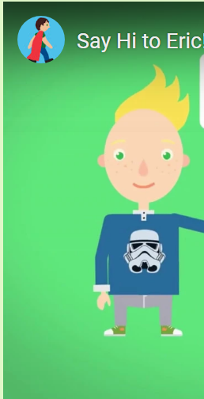
My One Piece of Advice to an Aspiring Social Innovator
‘Be geeky and learn as much as possible about the problem you want to solve. As a social entrepreneur you need to understand at every touchpoint where you can make a social impact, how best to do it and how you prove that you are making a difference. You won’t have it as easy as regular entrepreneurs who can simply point to their profit. So you need to be more knowledgeable’
Anton Håkanson

Slide 34
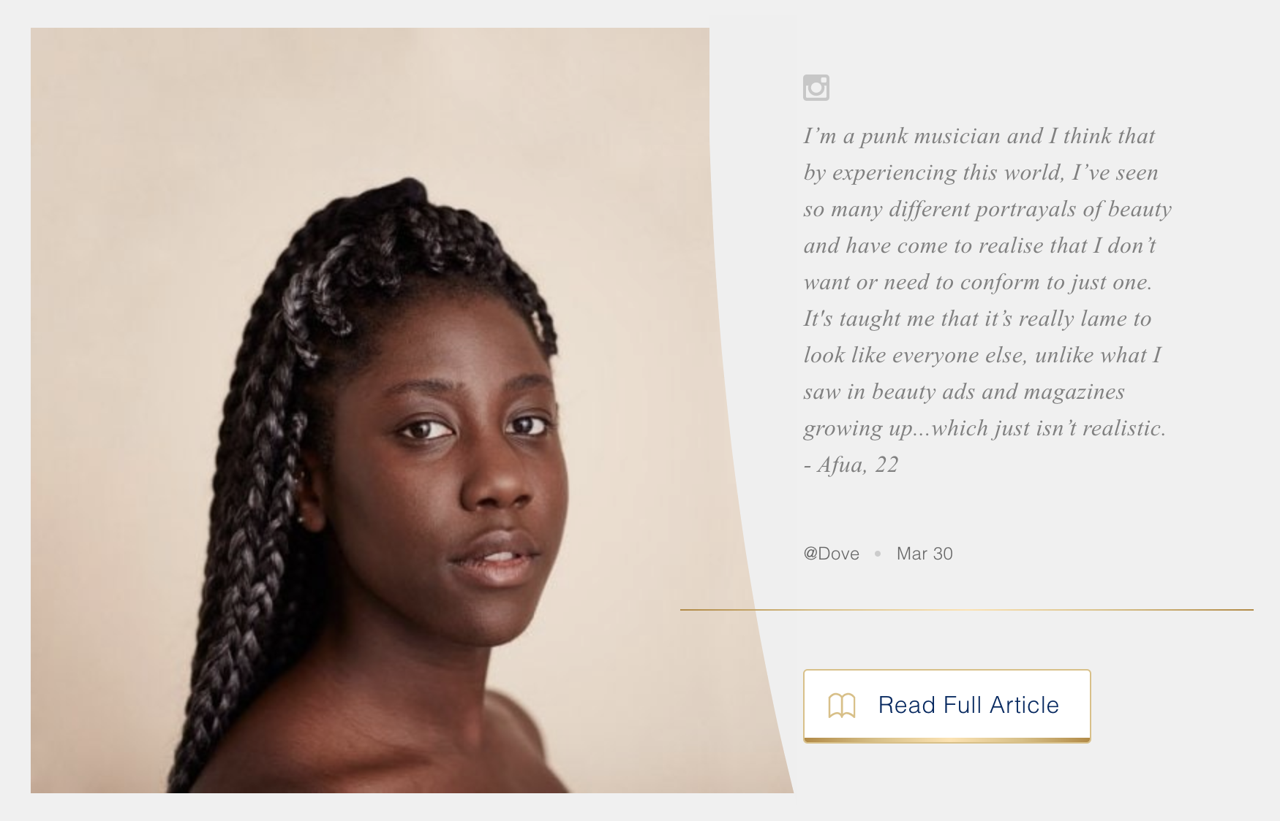
Talk About Your Customers
While every story should relate back to the audience, the consumer story or testimonial allows you to really understand how you fulfil your customer needs and preferences. This is also the kind of story that communicates the brand and businesses genuine appreciation for their customers.
Dove’s Beauty Portraits series is a great example of how emotional content or storytelling can related deeply and connect with consumers and provide them value beyond the reason they use the product or service.
Dove is a leader in promoting personal well-being and body positivity, taking on a brand activist role in many ways. It’s also done a great job in tapping its user base for real-world experiences, thought leadership and emotional stories that lift its brand and also inspire others.

Slide 35
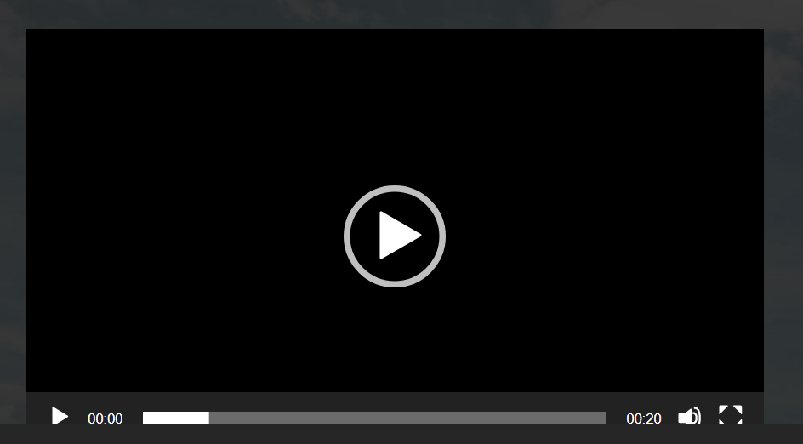
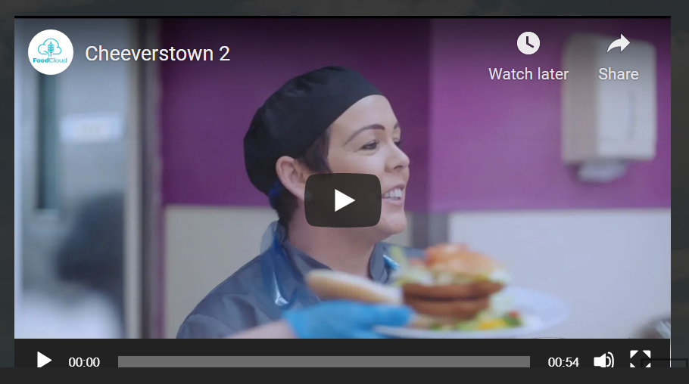
Talk About and Show Your Customers Stories
FoodCloud have a Community Page with more than 9,500 Community Groups across Ireland and the UK.
Below, you'll hear from two Community Groups about their own stories and what it means to work with FoodCloud
Start with one video, one testimonial and build on it.
Food Cloud, Ireland
What We Do
FoodCloud connects businesses that have surplus food with Charities and Community Groups that need it.
Our Mission
We have a mission to transform surplus food into opportunities to make the world a kinder place.

Slide 36
Reach the People Who Matter
The art of storytelling is in the writing but also in the delivery!
You have access to multiple platforms to share your story or message, deliver it in different formats (blog, Social Media, vlog, article…and more) so you can tell it across several platforms.
With consumers engaged on various communication channels, this multiplatform storytelling is necessary for you to reach the people who matter on their preferred channels.
Measure to See Where Your Audiences Are Engaging!
Write and tell your story to the platforms that suit your audience. If the data shows that your audience frequently visits Facebook and Instagram. Visual storytelling through images and video can be especially engaging on these platforms. Roll out more informational and inspiring social media videos.
Storytelling Capacity
What resources and skills do you need to create and share your story?

Slide 37
Digital Social Innovation Storytelling!
YDSI SPOTLIGHT
We created Kitche after I spoke with friends in the park one afternoon about the amount of food that people just chuck from their fridges. We wanted to do something to try and fix this. It was obvious to me that there were no platforms out there which addressed the amount of food waste in the home, despite it being the biggest source of waste.
Alex Vlassopulos – Founder of Kitche
Source: Daily Mail, photo Alex Vlassopulos Linkedin

Slide 38
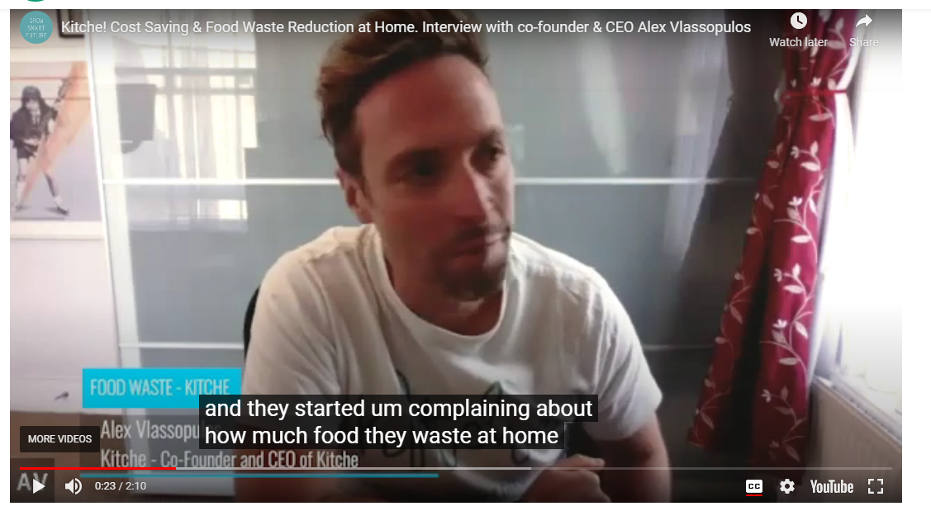
Young Digital Social Innovator, Kitche Storytelling Video
How Kitche Started!
Kitche is a free app designed to save you money and food waste at home!
‘Kitche is designed to reduce food waste and save you money at home. The average UK family tosses away about £70 of food per month. Kitche can help you stop this waste, using various helpful features’. Have a read in the next slide to see more examples of how they tell their story….

Slide 39
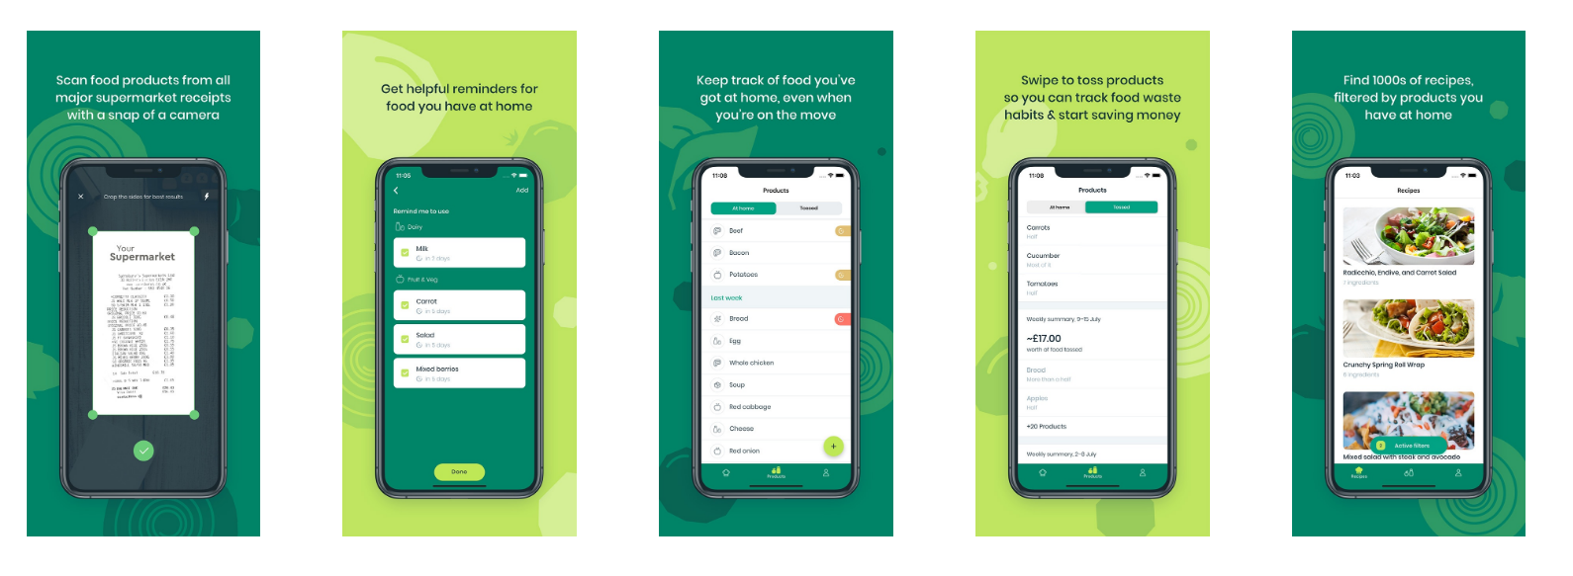
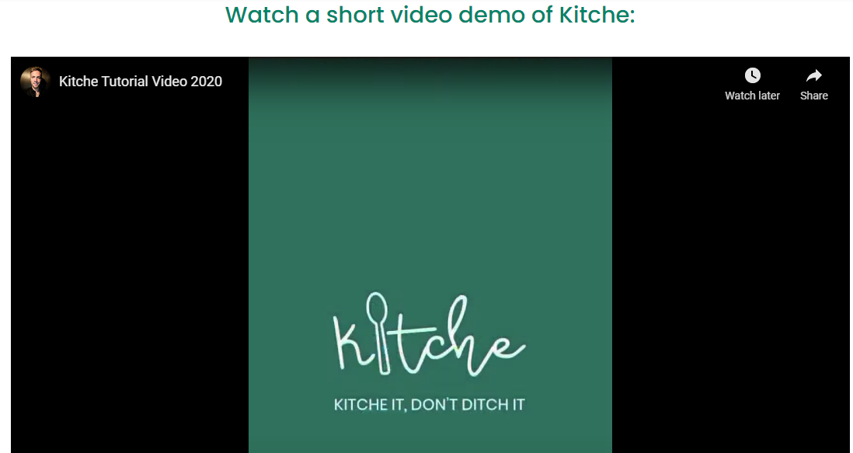
How Kitche Tells It’s Story!
Publications on Website. Kitche tell their story by publishing features on famous publications like Daily Mail, Metro…on their website
Graphics. Explain how Kitche works using simple easy to understand App graphics so people can understand and talk about it easily
Video. Have a Short Demo Video
Show People Credibility by showing who supports them. Press section in website (BBC, Mirror, ITV….). Sector Supporters on website (Tech Nation Net Zero, FoodTech…)
Social Media Channels

Slide 40
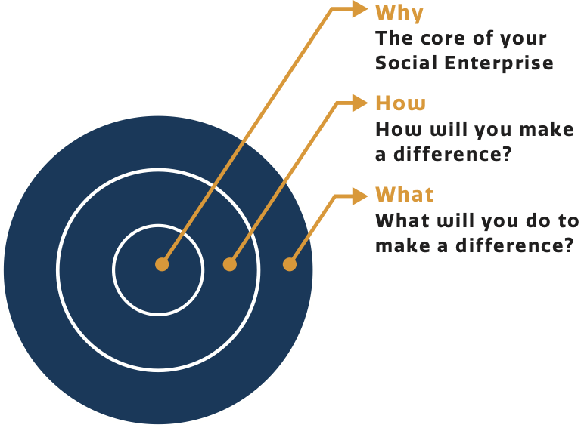
Exercise 1 – Developing Your Story
The following exercise is designed to explore your idea from a few different angles and establish if there are any gaps in your story that need to be addressed.
WHAT? Write down the main recipient issues and the three main ways you will address those needs or issues. Why should it be tackled your way? Why is your solution the best solution?
WHY? Write down how these issues have impacted people adversely? Perhaps someone close to you has experienced difficulties that could have been better addressed. If you don’t have personal experience you will need to research or spend time with the people who do have the experiences of the issues you are trying to tackle.
HOW? How are you going to do this? Using an App, a website platform, making a product, delivering a service?

Slide 41
Exercise 2 – Developing Your Audience Story
Collecting, organising and building your stories is critical to successfully storytelling delivery… Start with answering the below questions…
Who needs to hear it?
Prioritise what you want to say to capture peoples imaginations and interest?
What are the key things your target audiences want to hear?
What do they need to know that is of urgency?
How can they help you? (Tell them)
Where do you need to say it (website, social media, public event…)

Slide 42
Exercise 2 – Developing Your Recipients Story
Build a profile of one of the people impacted by the issue. Answer the following questions. This is the information that makes the story personal and real!
How were they impacted?
What are their characteristics? (where they live, their age, gender….)
Identify what the future looks like for them if something is not done?
What are their main barriers or challenges?
How big is the problem? Why is your idea needed? Is the problem growing or getting worse?
What is the best way to work with them so they can overcome such challenges

Slide 43
YDSI Storytelling Environment Example
Making Sense, EU
Mission Making Sense Mission uses the Smart Citizen Kit, an open-source Arduino-based environmental sensing kit, and other citizen sensing kits to empower communities and help them improve their environments
Target Markets European communities and citizens
How to Get Others to Help Using these kits, citizens create their own datasets, which they can take to government officials to persuade them to act on the problem.
How they Tell their Story Social Innovation Website Blogs, Social Media, Articles, Downloads, Attending Events, Making Sense Website, You Tube…

Slide 44
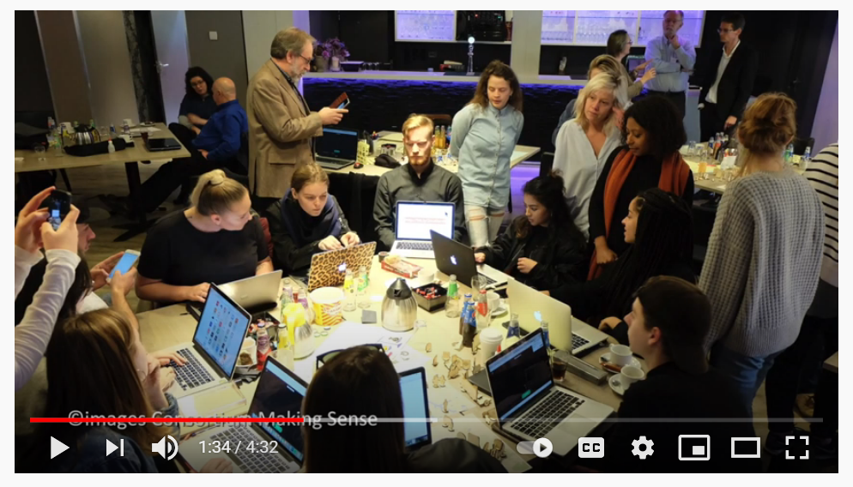
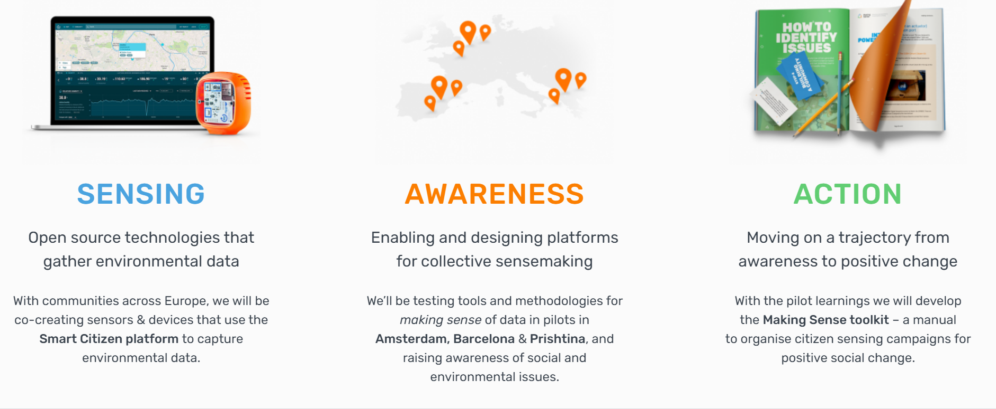
How Making Sense are Telling Their Story, Mission and What They Do Through Their Website
How Making Sense are Telling Their Story Through You Tube

Slide 45
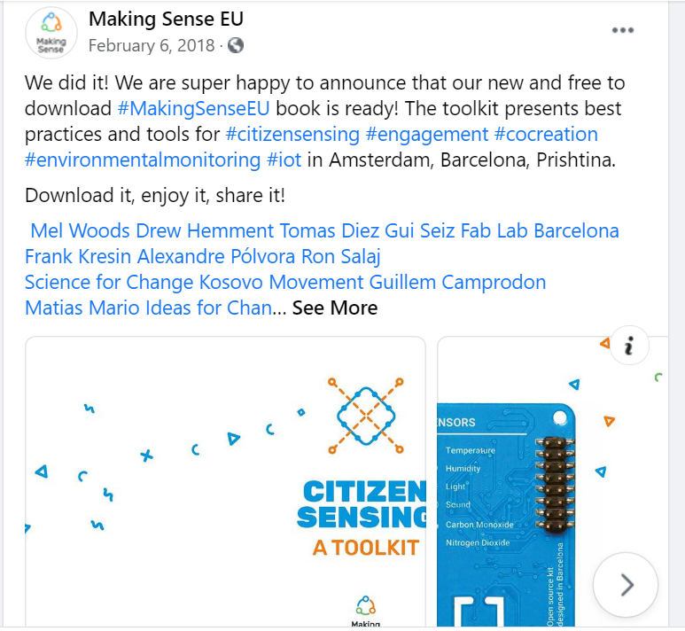
YDSI Storytelling Environment Example
Making Sense, EU
How Making Sense are Telling and Getting Their Story Shared Through Other Channels
They even developed a downloadable Citizen Sensing Toolkit for reading and sharing further information and understanding about their Story…
info@making-sense.eu
#MakingSenseEU
facebook.com/MakingSenseEU
slideshare.net/MakingSenseEU
github.com/MakingSense-EU github.com/waagsociety

Slide 46
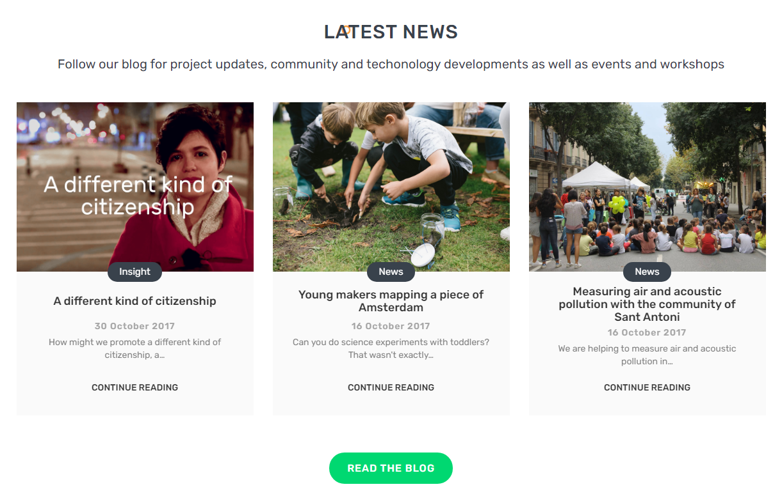
Making Sense
Getting Others Involved
Dedicated Page on Website and Series of Blog Stories
Let’s Collaborate
‘We’re looking for communities in Amsterdam, Barcelona and Prishtina to run test projects with. Do you have a social or environmental issue you’re concerned about? Let’s talk about how we can make sense of this issue using citizen science!’

Slide 47
Where To Tell Your Story!!
Storytelling Tools & Platforms
Radio & Article Interviews, Meetings, Podcasts, Live Shows…
You Tube Videos, Vlogs, Social Media Platforms…
You Tube, Social Media or Website
What platforms, tools and digital technologies you can use to tell and share your stories?
You must have a Website to Keep all your Content, Your Mission, Your Story, The Story of Those You are Trying to Help…How They Can Connect and Help too…
Ted Talks, Talking to People in General, Events, Public Speaking…

Slide 48
Sharing Great Stories
“No story lives unless someone wants to listen. The stories we love best do live in us forever. So whether you come back by page or by the big screen, Hogwarts will always be there to welcome you home.” - J.K. Rowling, author
What makes effective storytelling for your project?
Telling your story should be a key part of your promotion and communication
It should help others understand your values, mission and what makes your idea or project unique and a brilliant story to tell
It is important to keep your story alive - keep building, updating, adding, improving and creating the story as you evolve…
Share it in its many formats available (blog, vlog, twitter, social buttons….)

Slide 49
Digital Social Innovation Stories can be told in so many ways…Long Blogs, Vlogs, Twitter (140 characters), social media posts, digital news, articles, websites, case studies…
Attention and Engagement is Everything! You need to be able to capture the attention and imagination of people so they will take action (engage, share, get involved, purchase, donate, volunteer or inspire them talk about you…). Tell your story and the stories of those impacted by your project or could potentially be impacted. Technologies and digital tools can capture and share stories with a broader audience.
Intersection of story and technology. Digital technology can play a vital part in elevating your story as a means to help you achieve your Mission and reach your Goals in improve the wellbeing of the poor and vulnerable around the world.
Digital Tools are Perfect for Telling, Sharing, and Crafting a Captivating and Motivating Digital Social Innovation Story…

Slide 50
Many tools and platforms exist to enable us to tell our stories and connect with those we need to share our stories.
Social Networks are perfect platforms for telling stories with video, images, text and audio. You can post regularly, in real time and are perfect for getting conversation going in the ‘comments’ section.
Make sure to use mixed formats. It is always good to support a short text post with a video or link to provide further information. Unique hashtags to your idea are great for following how viral your content is. You can post the same post on multiple platforms but may need to change the structure depending on the options available
You can use tools e.g. Google Insights or Facebook Insights to tell you which platforms are better at reaching and engaging with your target audiences. These tools provide a detailed report. Learn by testing different types of posts and content and see what ones they are most likely to click on links, comment, share, view a video, go to your Facebook or follow or like you….Try and follow what worked for your most popular posts!
Platforms and Tools that Enable Us to Tell Our Stories Effectively…
Social Networks
Blogs
Email
Video and Audio

Slide 51
Blogs are fantastic for reaching wider audiences in a conversational, storytelling way. Tell engaging, relevant and on interesting content. Blogs can include text, videos, images, links to other pages or social media share buttons. Blogs and Websites can be developed using tools such as WordPress, Wix are simple and cheap platforms to develop and maintain. Don’t forget to ask your audience to share to their social media and start a discussion…
Email is essential for storytelling and keeping up to date with your audience, getting them to help and take action... You can also send out invites to events, ask them to volunteer or help you fundraise. Mailchimp is great for email development, they can also help you see ‘open rates’ (who is opening your content), check how many ‘clicks’ etc.
Platforms and Tools that Enable Us to Tell Our Stories Effectively…
Social Networks
Blogs
Email
Video and Audio

Slide 52
Video is the New Marketing!!!
Video & Audio like You Tube, Vimeo, Vine…are perfect because they use images, sound, movement and are arguably the most captivating digital format for storytelling.
‘YouTube has 1 billion unique users per month’.
Users are more likely to click on a video than other content. Videos can communicate emotion and show the lives of the vulnerable people featured in your idea. This can encourage empathy and understanding and motivate people to take action.
Content can be many things interesting, entertaining, moving, explain something difficult with visuals or ‘show and tell’. The cost of producing a video is very little but they must be high quality to make sure you are communicating appropriately
Audio technology such as Podcasts are also increasingly being used in storytelling.
Platforms and Tools that Enable Us to Tell Our Stories Effectively…
Social Networks
Blogs
Email
Video and Audio

Slide 53
Digital Story Tellers
No one person is
the hero, we all are!
Social Innovation Storytelling isn’t about making people feel bad, it is about informing and empowering people with what they need with your company’s help and assistance to make a difference. Its also so the charitable recipients are enabled with the capacity to make their lives better.
You will need to share your story…
Through using text, images, videos, audio, social media, website, infographics, downloadable kits….
Give your audiences facts and figures, photos of those in need (if possible name, age, location) so people can understand you better through what they see, hear and read. Use conversational language and tone. This will ensure you connect and create a conversation rather than just talk at your audience.

Slide 54
Digital Story Tellers Delivery Platforms
If you want to get consumers’ attention, try telling a story. If you want to reach them where they’re already engaged, tell your story online.
You will need to set up
Social Media (Business Facebook, Twitter for Business, Linked In Company Page, Instagram for Business…)
A Website with Mission Statement, Donate Buttons, Blogs, About Us Section….
You will also need a Business You Tube Channel and Playlist, attend complementary events and public speaking initiatives…
Don’t forget to ask people to spread the word, share, support, contribute, donate, engage or just follow you…

Slide 55
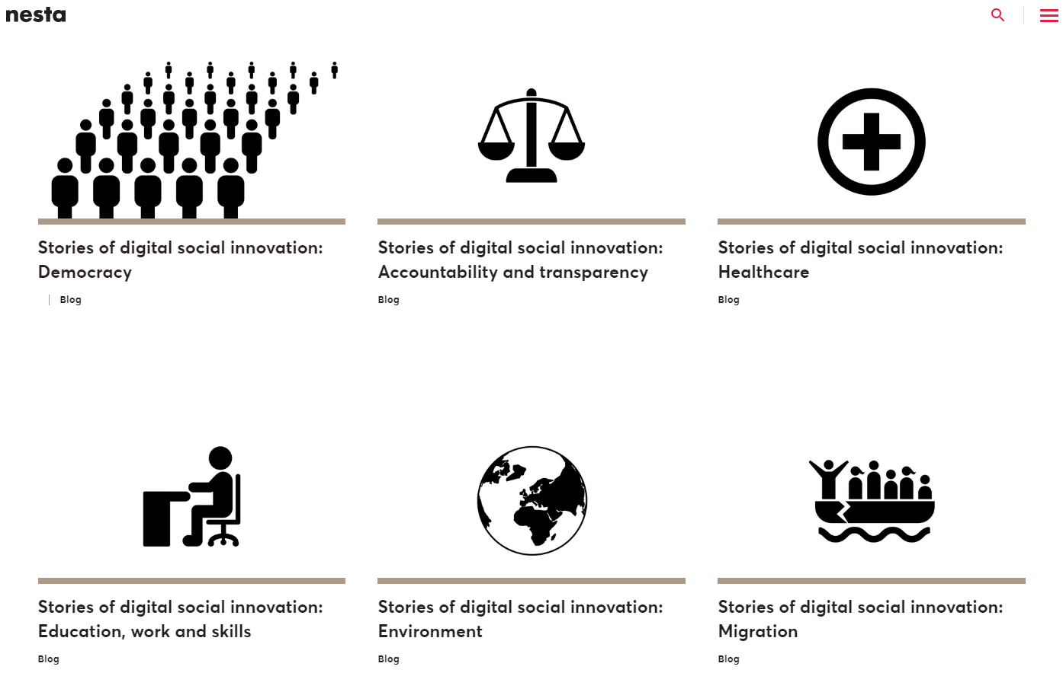
Make Sure to Go to your National Social Innovation Network so They Can Also Tell and Share Your Story!!! Write Your First Blog and Send it to Them.
Get Behind Each Other as YDSIs and Support and Promote Each Other!
Young Social Innovators, Ireland
Young Social Innovators, UK

Slide 56
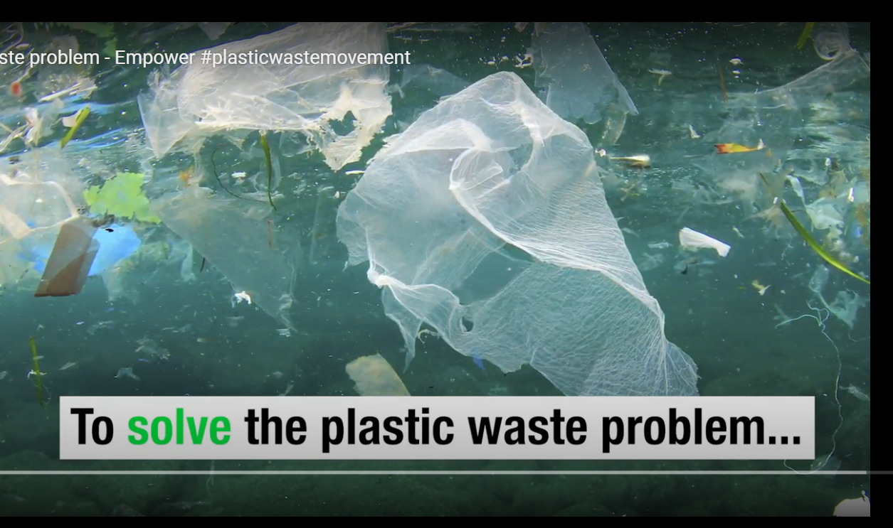
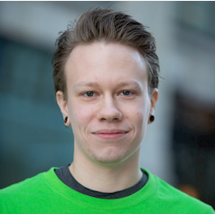
How Empower Tells its Story
Gjermund Bjaanes, Netherlands
Promotional Video on Website, Social Media Channels
and You Tube
Solving the Plastic Waste Problem
Empower is creating a solution to the plastic waste problem by giving plastic a value. We are cleaning up the world while fighting poverty by providing a wage to those in need.
Gjermund Bjaanes, CTO & Founder

Slide 57
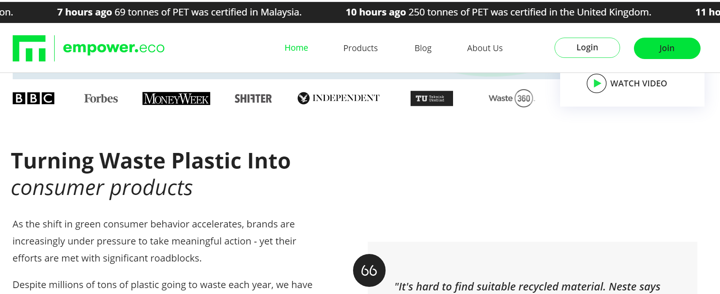
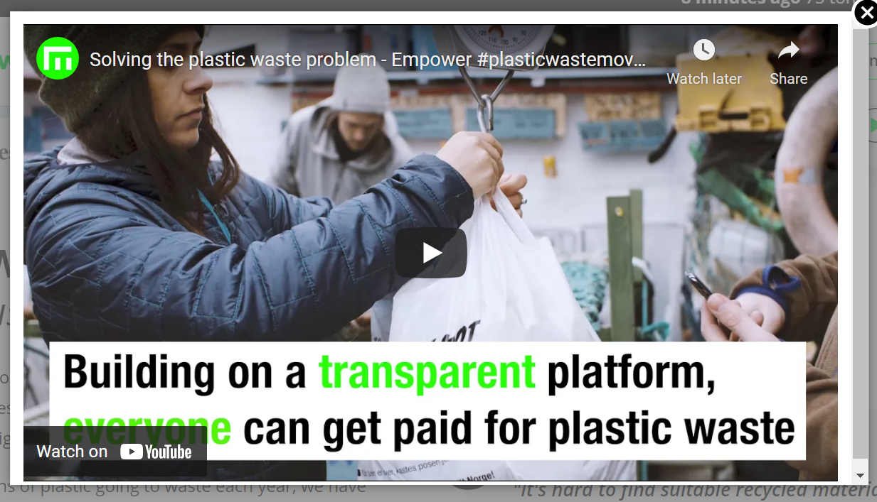
News Reel displaying their impact at the top of their website, constantly updating across the globe
Website Landing Page
Mission
Identifying the problems and challenges
Their accessible solutions
How empower tell their story through their website to generate awareness and get people to join and share their cause!
Join Us Button
So people can sign up or send a question. People can subscribe so empower can send emails and keep their supporters updated
Display Media
All the publications that they are in and supported by

Slide 58
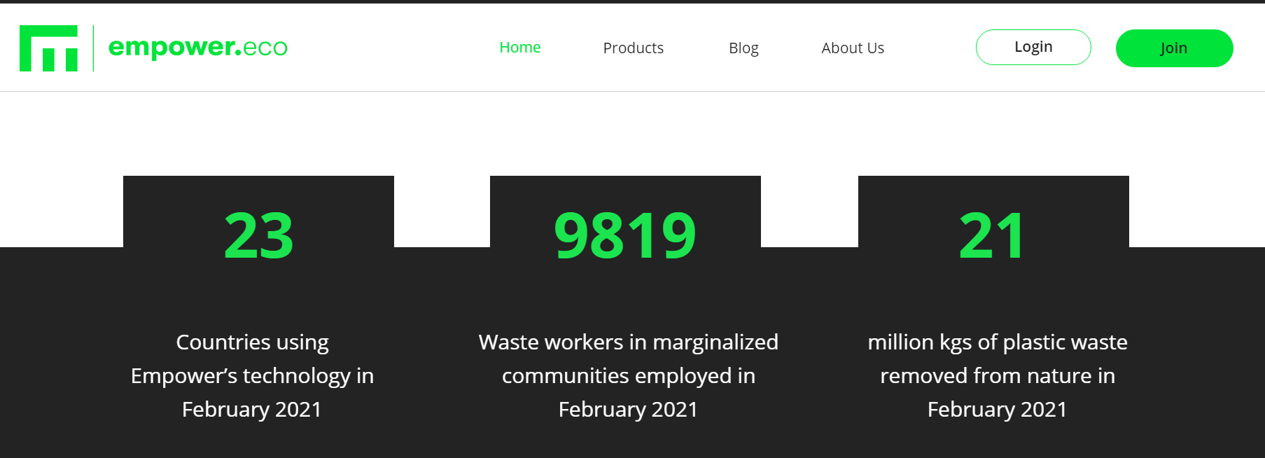
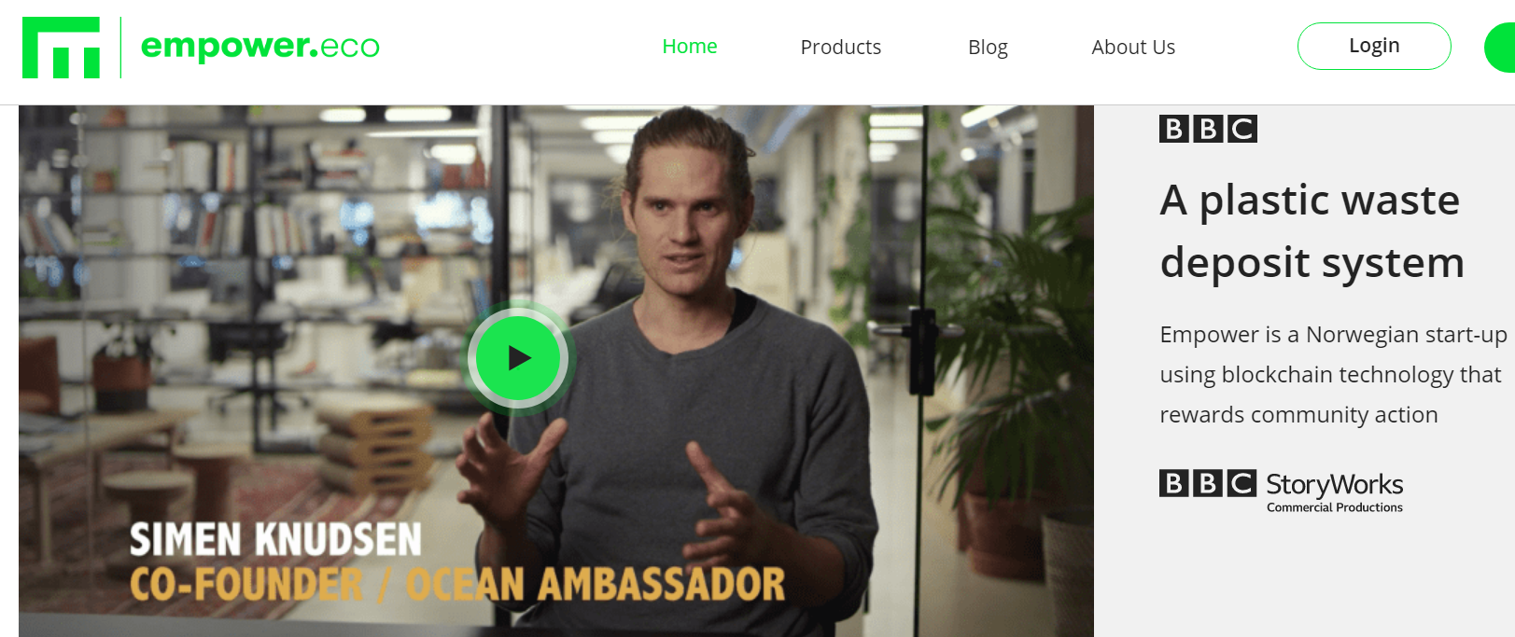
How empower tell their story
About Us Section on Website
Publicise and Share Articles from Prestigious Companies
Update the public and their supporters monthly using graphics in the Total Impact Section (Where they are active, enabled employment, how much plastic recovered)
Video to tell the story of How empower.eco began

Slide 59
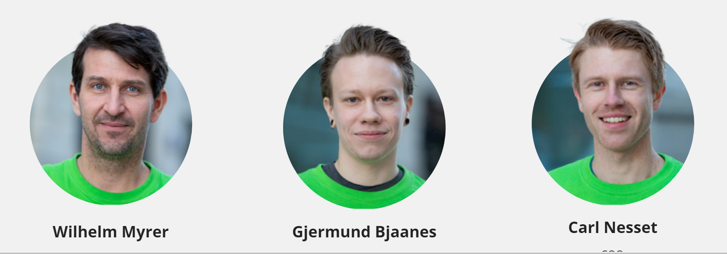
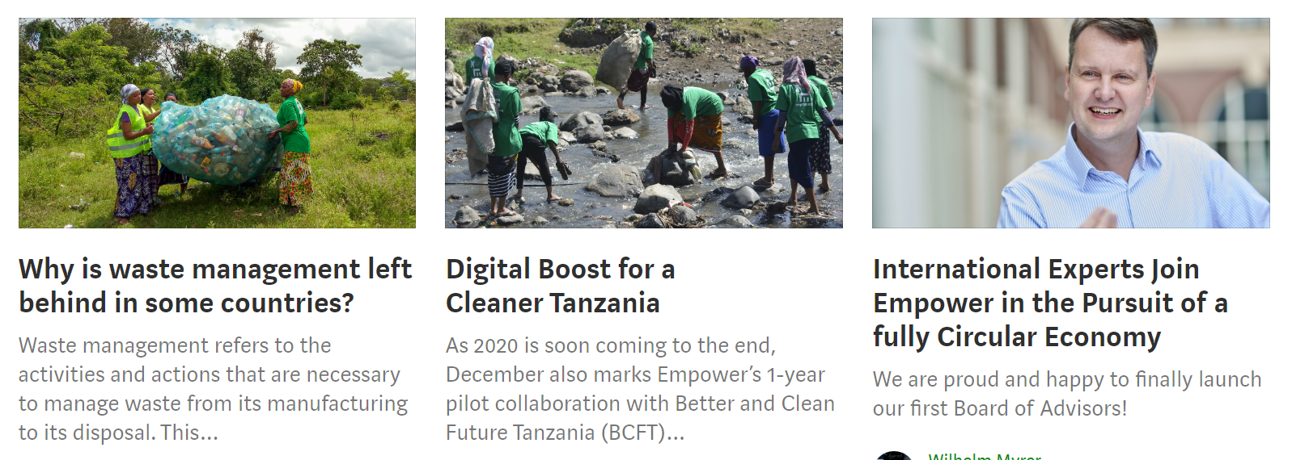
How empower tell their story
Get in Touch Section to communicate and educate
The story behind each of the founders
Supporters and Alliances
Graphics so readers understand easily how it is done, QR code to bring to specific page ‘products’
Case Studies how it helps make an impact to other big companies like DOW
News Section with Blogs One article showing how experts are getting involved and helping
Social Media Channels

Slide 60
Exercise – Start Telling Your Story
Start Storytelling. Sit down with someone who doesn’t know anything about your idea. Tap into your storytelling zone. Start with your mission and statement, then tell them about your story and the stories of those you represent…
Ask for honest feedback. Do you understand what I am doing? Do you understand the need? Did I give you enough information? Was there anything missing? Is there anything I could improve on? What did you like? What did you not like? Did I speak clear enough? Etc.
Next Step Showtime. take the feedback and record yourself on a You Tube Video to see how it comes across. Once satisfied make it public. Congratulations you have developed your first storytelling vlog.

Slide 61
Congratulations!
You have completed all 6 Modules of Young Digital Social Innovators. Enjoy your adventure and be proud of the impact you are making to ensure this world is a better place for all those who need a little help. Remember don’t forget to ask for help too!
email
website

