Slide 1
Module 5
How to Finance and Fund your Digital Social Innovation Idea

Slide 2
Module 5 Learning Objectives
Get your social innovation business or idea off the ground using minimal resources and frugal innovation, a tour of where to get the right start up supports for starting a lean start up
Understand the different funding approaches and ways to finance your business. How starting small and frugal and starting local is often the best way to go. How you can fund your business without getting out a loan or a finance package.
Learn how to pitch in 3 mins to potential investors, funding agencies, support agencies and the public so you can articulate and sell your idea and get them onboard.

Slide 3
In this Module you will also learn how to develop start your Digital Social Innovation with resources and funds using Frugal Innovations and Alternative Finance options.
You will discover how to approach your idea in an intelligent way using low-cost flexible solution through approaches such as Lean Start-up and Frugal Innovation. You will develop a flexible mindset that will help you respond to your limitations whether it be financial or material and turn constraints into an advantage.

Slide 4
Module 5 Topics Covered
How to Fund and Finance A Digital Social Innovation Idea: Different Ways to Access Funding, Finance & Support
5 WAYS TO START & FUND YOUR DIGITAL SOCIAL INNOVATION Business/Project: Spotlight on….
Lean Start Ups – sometimes less is more!
Finding Your Local Cheerleader – who is going to hold your hand and support you along the way!
Frugal Innovation meets Social Innovation
Impact Investors, Crowd Funding… – spark investors and the publics interest and get their funding support!
Social Innovation Competitions, Grants & Awards – not only brings acknowledgement but funds too! Join their networks for support.
THE PERFECT PITCH: How to pitch to potential funders; governments, agencies, equity investors, investment organisations who provide funding for projects that support digital social innovation
Overview
How to use these Modules! These Modules can be adapted, modified, shortened or combined however you think they will work best for you and your students learning. Please respect copyrights, branding and acknowledgement that these resources and materials were developed by Young Digital Social Innovators with the funding and support of the Erasmus+ European Commission.

Slide 5
1. Lean Start Up
Social Innovation
What is a Lean Start Up? It is about getting your products and ideas to potential customers quickly, saving money, time and having greater success.
The lean startup’s mantra is “build, measure, learn” — do regular tests, get real-world feedback on them quickly and use that data to identify what works and discard what doesn’t. And then test some more.
The good thing is technology has enabled it to be simple, fast, efficiently build and easily connect.
The ability to make small batches is easier than ever before on the web, in virtual space.
Watch Video

Slide 6
Tips for Starting a Lean Social Innovation Idea
1. Figure Out Your Market
Social enterprises are businesses, selling either a service or a product to make money. To do this you need to be able to know and sell to your target market. So consider carefully: who is going to buy what you are offering? Is there competition?...
Lean Approach: Now how can you connect with the right customer so you are constantly listening and modifying to achieve the perfect idea. Next what is the MVP Minimal Viable Product required to test and gauge interest with customer interviews.
Further Reading Lean Start Up for Social Entrepreneurs of Design Thinking

Slide 7
Tips for Starting a Lean Social Innovation Idea
2. Get Some Advice (Mentor)
When starting up a social enterprise there will be lots of new challenges and critical decisions to make. How do you ensure you’re making the right choices so you can succeed in making the impact you want to make? Having someone on your side with business experience that can offer good advice can be a godsend. And for that, you need a mentor.
Lean Approach: It is good to get a Mentor at this stage to help you refine and develop your Solution? Having gained an in-depth understanding of the problem and its effects on the users in Module 4 you have a pretty good idea of what your solution might look like. Might! That’s right. You are still not building anything other than a concept or idea of a solution. This is called your Value Proposition. This is the ultimate goal you want to achieve for your Business Plan. It describes what kind of value you are creating and how you are solving the problems for your users you want to work with. Your mentor will help you understand what is wrong, what is right and where to go from here….!

Slide 8
Tips for Starting a Lean Social Innovation Idea
3. Have a Clear Mission
As a social enterprise, you are going to get asked about your mission A LOT. It’s what makes you stand out. Funders will want to be sure about the social change they invest in, and customers will check you’re different from less ethical alternatives. Then whether you are approaching potential funders, volunteers, staff or supporters you need to be able to clearly communicate your idea.
4. Figure Out Funding
How will you fund your social venture? If you haven’t got a pot of start-up cash, don’t despair. A number of organisations are willing to give you some money to get your project started if your idea is convincing enough. Here’s our guide on finding money to start up a UK initiative. Go to your DSI Map to find your local funding options. In the following sections of this Module you will learn different ways to fund your YDSI Idea.
Lean Approach: How can you build and develop this product with little investment?

Slide 9
Tips for Starting a Lean Social Innovation Idea
5. Measure Your Social Impact
Impact measurement is absolutely key to identifying and engaging with relevant stakeholders, investors and funders. Measuring social impact will allow you to prove what you difference you can make and how many will be positively impacted. Proving impact demonstrates to stakeholders (including funders) that what your will do will make a significant difference (or not).
6. Write a Business Plan
A business plan is there to provide all the answers that anyone might ask about your business. And, to state the obvious, it is a plan – a home for all the thinking that you have done about how to make this thing work. Anyone interested in your business (particularly investors) will ask to see your business plan, so it’s good to have one even if you don’t think it’s perfect. Here is some guidance to hold your hand through this, and you can find good examples with a quick google search.

Slide 10
2. Find Your Nearest Cheerleader!
Your cheerleader is someone or a network that will support you throughout your start up journey. They will stand with you and back you up, encouraging, influencing, believing in you and guiding you where possible. They want to see you do well and succeed.
Good to know you have done an awful lot of homework so far in Modules 1-4. As you have learned there are so many resources and supports out there so you will never be alone. If in doubt go to a network and support to give you advice. Want to know more check out your local cheerleaders check out Digital Social Innovation Europe.
Example for the UK sector Social Enterprise UK’s or Nesta’s website. UnLtd, the foundation for social entrepreneurs, also has a learning area which features lots of advice to help get you up and running.
Example for Irish sector Young Social Innovators which have Programs, Young Success Stories, have a Learning Lab, Awards Programs and so much more…
Lean Approach: getting right to the heart of the right advice and support for your social innovation business without wasting time, money and effort
Further Reading on the Full 10 Steps

Slide 11
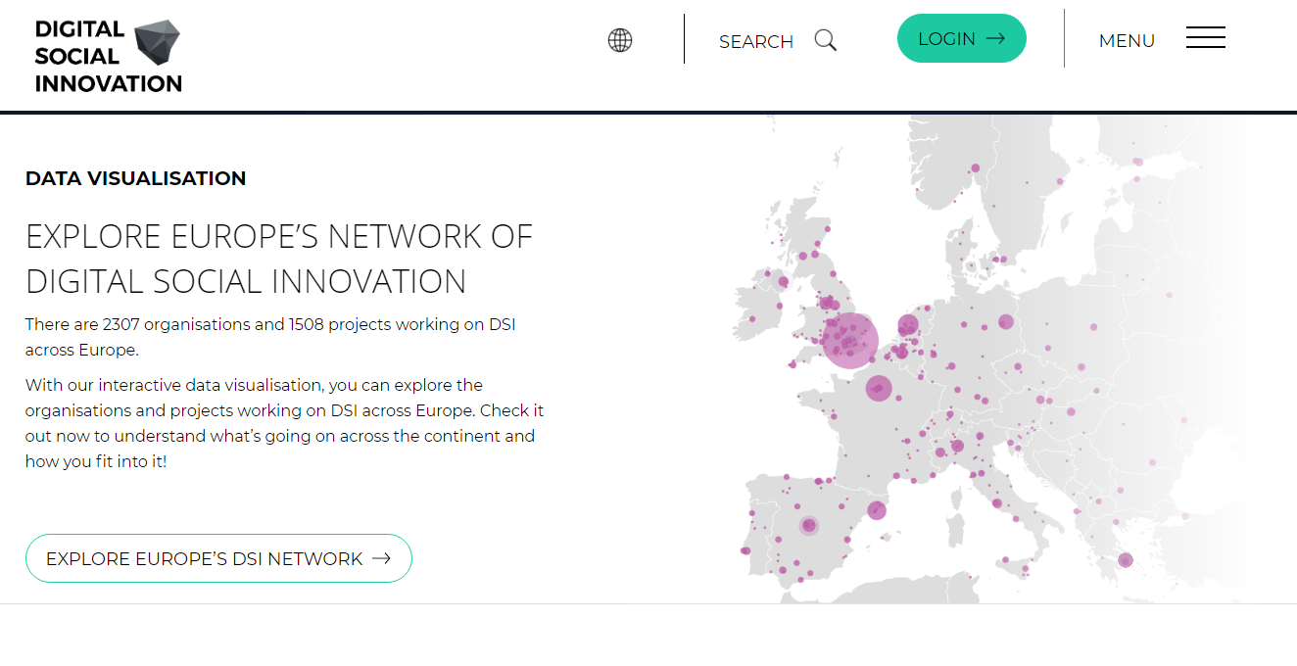
Find Your Cheerleader!
Explore Europe’s Growing Network Of Digital Social Innovation
Digital Social Innovation Networking & Support Across Europe
Join The Community 0f 2,307 organisations and 1,508 projects using digital technologies to tackle social challenges
Read and Engage on Funding, Events, News and Blogs, Fab Labs, Networks, Collaboration Spaces…specific to your country!
Click on your country on the map and explore what is available in your country…

Slide 12
3. Frugal Innovation meets Social Innovation
Frugal Innovation responds to limitation in resources, funds, material..
Frugal innovation is the ability to start and keep a business going sustainably and providing social value with scarce resources. It’s about solving—“doing more with less”. Frugal innovation is a game-changing strategy for social innovation businesses to be cost-conscious and eco-aware to create ideas that are simultaneously affordable, sustainable, and of high quality. Even more than a strategy, frugal innovation is a whole new mindset, a flexible approach that sees resource constraints not as a challenge but as a growth opportunity.

Slide 13
What is Frugal Innovation?
By minimising the use of resources in development, production and delivery of by approaching them in new and intelligent ways, frugal innovation results can dramatically improve your business by lowering the cost in your products and services.
Frugal Innovation can have an explicitly social mission.

Slide 14
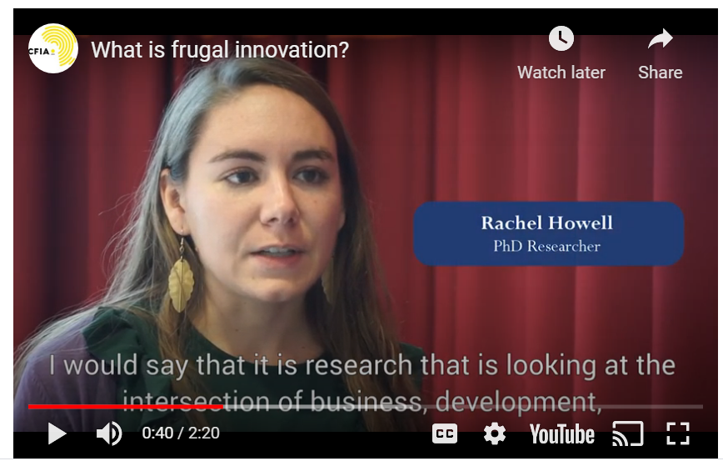
Watch…
What is Frugal Innovation?
Frugal innovation aim to offer smart, simple and affordable solutions. Frugal innovation processes start from the identification of needs and bottlenecks especially for underprivileged sections in society.

Slide 15
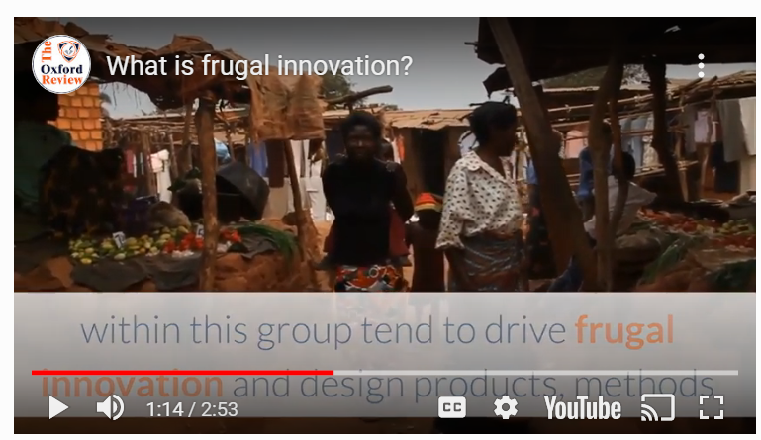
Watch…
Frugal Innovations can have an explicitly social mission…
Refers to low-cost new products, methods and designs that have been created for or come out of what is known as the bottom of the pyramid or the unserved lower end of the mass-market.

Slide 16
What is the Difference between Social Innovation and Frugal Innovation?
Social Innovation
‘The transformation of social systems in ways that both address social problems in a practical sense and shift our ways of thinking about these problems’ Lawrence, Phillips and Tracey 2012, p.321
‘The term ‘social innovation’ is used to describe a broad range of organizational and inter-organizational activity that is ostensibly designed to address the most deep-rooted ‘problems’ of society, such as poverty, inequality and environmental degradation’ Tracey and Scott 2016, p.51
Frugal Innovation
‘Frugal innovation—the creation of faster, better and cheaper solutions for more people that employ minimal resources’ Prabhu, 2017, p.1
‘Frugal innovation is the ability to ‘do more with less’ Radjou and Prabhu 2015, p.xvii
‘…a design innovation process that properly considers the needs and situation of people in the developing world is necessary in order to develop appropriate, adaptable, affordable, and accessible solutions, products and services’ George, McGahan and Prabhu 2012, p.663

Slide 17
Before you adopt a Frugal Innovation approach You Need to Take Into Account…
The low incomes of the markets you are serving? – Are your goods and services affordable? Can you create an income opportunity for the poor…?
Is the design valuable? i.e. Is your idea environmentally friendly and sustainable? Can you offer it to your customers in a good quality?
Is your idea accessible to your users? – Can they get it when they need it? Can they get if offline if they do not have access to the internet or a computer? Can anybody that needs it get it? If they do not have the money to purchase is there another way to get it? (e.g. can it be donated, is there a fund for those who can’t afford it?)

Slide 18
New ideas that work in meeting social goals need Frugal Innovation
Frugal Innovation requires a shift in mindset from value for money to value for many
(Govindarajan and Trimble 2012, p. 150).
‘Social Innovation Challenges such as provision of clean water, universal health coverage, climate change, endemic poverty, lack of affordable education, catastrophic disasters, neglected elderly, environmental degradation, humanitarian relief, and economic, cultural and gender equality need a Frugal Innovation Approach’

Slide 19
Think with a Frugal Innovation Mindset
How to improve competitiveness while reducing costs and improving quality?
What are the existing local social problems e.g. no money, only basic infrastructure…
How to solve big social problems by thinking small (with limited resources)?
How to provide value sensitive innovations without sacrificing user value?
How to develop frugal innovations to fit local circumstances and cultures in order to be successful for both suppliers and demanders?

Slide 20
Example of Frugal Innovation
Mitticool – The Earthen Refrigerator
Social Innovation inspired by adversity
Adversity In 2001, an earthquake devastated Mansukhbhai Prajapati village in the Indian state of Gujarat. Homes were devasted (including fridges - no fresh food)
Frugal Innovation He came up with a simple solution by doing more with little resources. He set up a factory in rubble and trained local women to make refrigerators with - clay!
Social Innovation Providing his female employees with an additional income, provided an affordable fridge to other people that they could purchase on the internet

Slide 21
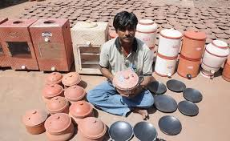
Example of Frugal Innovation
Mitticool – The Earthen Refrigerator
Frugal and Social Innovation Questions?
“How do we create a refrigerator cheap enough for poor people to buy, and provide affordable electricity to operate it?”
“How do we take materials readily available at an affordable cost and turn them into reliable refrigeration?”
‘How do we get marginal people to not only be beneficiaries, but become part of the solution?’.
Mansukhbhai followed his heart and his mind with persistence
Frugal Innovation Simple Design helps to conserve resources, is eco friendly and safe. The simple design also ensures that his innovation can be accessed and used anywhere and easily maintained

Slide 22
Example of Frugal Innovation
Mitticool – The Earthen Refrigerator
The refrigerator uses a cooling effect from water evaporation to achieve a lower temperature
Now provides numerous products to 63+ cities; Earthen Clay Water Bottle, Earthen Filters, Cookware…
It also keeps India’s traditional wisdom and pottery skills alive
Benefits of Using clay in Water Bottles and Kitchen Ware reduces the waste of plastic, chemical free homewares, prevents acidity as clay has alkaline properties, cheaper, healing powers from the minerals in the clay…

Slide 23
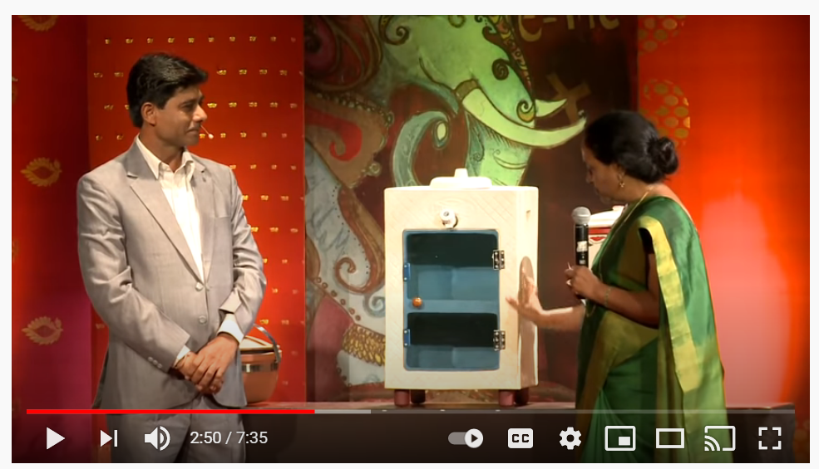
‘Mitticool, the clay refrigerator that requires no electricity, costs less than $50 and can keep food fresh for 2 to 3 days, is just one example of the power of “frugal innovation”, Mansukhbhai Prajapati
Frugal Innovation
Building Modern Technology With Clay
Mansukhbhai Prajapati, trained as a tile manufacturer, makes modern kitchen appliances like the refrigerator and nonstick pots and pans... out of clay.

Slide 24
Frugal Innovation Forum
Over 200 Development Practitioners, Innovators, Entrepreneurs, Investors and Activists
Where 85% of global youth are building a future for all of us to thrive in.
Frugal Innovation Forum (FIF) is a platform for leaders from the Global South to connect and explore solutions to the world’s toughest challenges. FIF 2019 will explore the theme “Scaling opportunities for youth”, featuring development practitioners and funders, young change-makers and innovators in a 2 day long conference to collaborate for impact at scale.

Slide 25
Frugal Innovation is more important than ever with a recent financial crisis, COVID-19 Europe is in need of an approach to innovation that focuses on delivering affordable, fit for purpose and easy to use innovations and technologies. Frugal Innovation offers solutions for the challenges that emerge.

Slide 26
ICTs as an Approach to Frugal Social Innovations
Information Communication Technology (ICTs), for example mobile devices and applications, are arguably the dominant technology of our time. From a consumer perspective, ICTs may be considered a form of ‘frugal’ innovation, as they present innovative, low-cost solutions to everyday problems that are flexible and accessible for users with limited resources. If used effectively, ICTs have been cited to be a major ‘game changer’ in human development, driving progress in the Sustainable Development Goals (SDGs) and fostering potential gender equality and empowerment.

Slide 27
ICTs as an Approach to Frugal Social Innovations
Increasing use of mobile technology in humanitarian assistance, for example enabling cash transfers through mobile money, and facilitating access to basic utilities including energy, water and sanitation.
Mobile phone apps for public information and support, for example the establishment of WhatsApp chatbot services can provide local coordination to vital protection during COVID-19 pandemic…
The next section will demonstrate with examples how this is done….

Slide 28
Example Refugee WhatsApp
Grassroots innovations to get communities engaged to solve their own immediate problems
ICTs as an Approach to Frugal Social Innovations
A simple Refugee WhatsApp Group is an example of how ICTs can boost refugee women’s self-reliance and resilience
Simple ICT tools can be useful in local digital communication, including reaching poor and illiterate refugee groups (through voice messages/pictures)
ICT tools can permit vital social solidarity and economic coordination, sharing, survival support and online marketing & communication
ICT tools can also facilitate the sharing of public health and security information, and the countering of fake/false news that is often distributed via social media or ‘on the streets’

Slide 29
EXAMPLE YDSI – Thrive for Change
Holly Ritchie, Netherlands
Thrive aims to support the professional development and empowerment of women in humanitarian work through online and onsite training & capacity-building services.
Social Innovation Refugee Inclusion and Integration Project to support refugee women’s physical, financial and social wellbeing and provides leadership training.
Frugal Innovation Start with a Self Funded Project
Digital Social Innovation To date, Thrive has supported several internal workshops and training in physical (physical and mental), financial and social wellbeing through a series of Online/Offline Courses
The main objective of the 7 session courses is for participants to gain basic knowledge on all aspects of starting up a social enterprise, to develop critical entrepreneurial skills and to gain a valuable network of other aspiring entrepreneurs and change makers.

Slide 30
4. Impact Investors, Crowd Funding
Impact Investments
Impact Angel Investors
Challenge Prizes
Types of Crowdfunding
Start Up Social Innovation Support Networks
Enterprise Agency Support

Slide 31
Get to know Alternative Finance
Alternative finance is providing significant additional support to ‘giving to social good’ projects that they would not otherwise be able to secure.
It is estimated that more than three in four backers of projects with a social focus provide funds and additional advice and support compared to what they would normally give to charitable causes (e.g. marketing expertise, mentoring, connect to contacts and influencers etc)

Slide 32
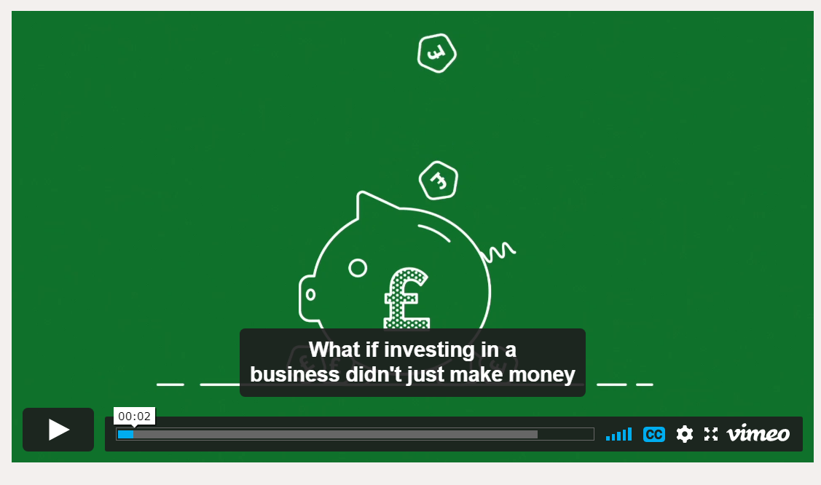
Impact Investments
Watch Video….
What are Impact Investments?
Is investing in high impact innovations run by entrepreneurs that create real and lasting social impact in the UK as well as generate a financial return for investors.
Nesta, UK

Slide 33
Nesta Impact Investments is a £17.6m fund investing in life-changing innovations that help tackle the major challenges faced by older people, children and communities in the UK.
Nesta’s Impact Investments include an experienced team of sector experts, venture capitalists, impact investors and evaluators backed by Nesta. Committed to supporting outstanding entrepreneurs, Nesta bring the skills, networks and resources to support social innovation ventures to deliver on their mission.
Nesta provide their portfolio companies with expertise and guidance, helping them to grow their reach, demonstrate their impact and become financially sustainable.
Nesta Impact Investments is managed by Nesta’s fund management arm Nesta Investment Management, with funding from Big Society Capital, Omidyar Network and Nesta itself.
The fund launched in November 2012 and aims to make a total of 15-20 investment over its life.
Apply for Investment here….

Slide 34
Company: Reload Greece
Building A New Generation of Young Entrepreneurs
to Create Ventures with a Positive Impact
in Their Countries
Effie Krytata, Reload Greece (RG), UK
Reload Greece is an educational charity that aims to create new generation of entrepreneurs to build businesses that will have a positive impact on their home country, Greece.

Slide 35
My One Piece of Advice to an Aspiring Social Innovator
‘Don’t overthink, just get started! There are always a million reasons that can hold you back and never get to even start what you want because of fear. With determination, hard work and great passion in what you want to achieve, anything is possible’

Slide 36
Interview with Young Digital Social Innovator
Effie Krytata, Reload Greece, UK
Full Interview
Q1 How did you come up with the idea? Was a creative or collaborative process involved?
We started as a group of 5 volunteers who had a common vision and passion to address the problem our generation was facing but Reload Greece found many people along the way who had a common belief and purpose and joined the ‘Reloader’ movement. We now have a community of more than 150 volunteers and a wider community of more than 20,000 people who are engaged in our work. Collaboration is a key value of our organisation; we are open to new ideas, don’t shy away from new opportunities and work together as a team to stay motivated and get the job done.

Slide 37
Interview with Young Digital Social Innovator
Effie Krytata, Reload Greece, UK
Full Interview
Q2 What were the beginnings of the social innovation? (i.e. how did you build your initiative, business, NGO from zero?).
We started Reload Greece while we were still at University or working on our full time jobs. We would all get together during the evenings and weekends and grew our volunteer base from 10 to 25 people. A Professor at the London Business School who teaches on strategy and entrepreneurship enabled us to grow the organisation by appointing two of us as his research assistants. This gave us the opportunity to work on Reload Greece full time. Also employed a couple of incredible interns and MBA students from the University who helped us develop our initial business plan. We recruited our first Board Members and applied for our first round of funding to corporates, foundations and individuals who believed in our cause and what we wanted to achieve.

Slide 38
Interview with Young Digital Social Innovator
Effie Krytata, Reload Greece, UK
Full Interview
Q3 How did you make sure that your idea actually fits the needs of the users?
We ran focus groups, we did surveys we ran pilot events. We constantly sought and seek feedback in everything we do. We asked our community what is it that you want to see from what we are building, what are your needs, how can we help? Our door has always been open to hear new ideas and adaptation is key when you are shaping something new.

Slide 39
Interview with Young Digital Social Innovator
Effie Krytata, Reload Greece, UK
Full Interview
Q4 How did you raise the money for your idea and what is your advice for others considering DYI fundraising?
We raised our first round of funding by having a solid team and plan and our legal charitable status approved by the Charity Commission. We had a clear direction and knew how we were going to get there and were very passionate and committed to follow the plan through no matter what. This was very important when approaching individual donors and organisations. We have been very humbled to have received the invaluable support of esteemed foundations, corporates and individuals without whom, we would not have been able to grow our organisation and to whom we are very grateful. Key I think is turning up prepared, know what you want to achieve and how you are going to get there setting out your three year plan. Having a team whose skills are also complementary is key as it proves you have the driving force to execute on your vision.

Slide 40
Impact Angel Investors
Jay Morris, a social entrepreneur and the portfolio director for the Peery Foundation, suggested the best place to go for capital is “your backyard.” His recommendation is to start by reaching out to your own networks as people will be more willing to invest with you if there is already an established relationship, level of trust, and interest in your success.
Traditionally, angel investors invest in start-ups and early-stage companies that they believe show great potential for growth and profit – offering healthy returns for those individuals taking on great risk at this early point in the life of the business. This is still true for impact angels, with the additional fact that they are searching for businesses with strong social missions and the potential to create real, scalable environmental or social change.

Slide 41
Impact Angel Investors
Impact Angel Investors
Clearly Social Angels
Impact focused Angel Investing Group
Clearly Social Angels, the UK’s first impact-focused angel investing group, which has brought us into contact with many of the “early adopters” of this form of investing.
Clearly Social Angels investments are targeted towards innovatively social businesses. Examples of Investments include…
Debt investment into Fair Finance (providing microfinance to the financially excluded)
Investing £300k into Playmob (offering in-app purchases through games to support charities like Global Angels, which works for safe drinking water in India).
Investment e.g. £200k equity investment into Breezie, which offers software for tablets helping get the digitally excluded online.
What are the motivations for Impact Angels?

Slide 42
Impact Angel Investors
Impact Angel Investors
What are the motivations of Impact Angels?
Read More
Philanthropy or charitable foundations who have a particular focus. Make sure you match up with their aims
Supporting You they may offer expertise, contacts or capital ‘One of the investors explained that his business had been successful with the support of a community; he could use the capital they had helped him earn to create social change for a large group’.
Add to Business List Others see impact investing as a good way to add good businesses to their list. Investing in companies that combat climate change, or offer solutions that reduce its effects is a good investment.
Extremis, for example, creates pop-up houses for those who have lost theirs through natural disasters), has great potential for long-term returns. So it’s sensible impact investing – it’s the kind of investing that makes sense in a world that needs to address sustainability!

Slide 43
European Business Angels Network EBAN Drives successful and responsible Angel Investing in Europe, has over 150 member organizations in more than 50 countries
Business Angels Ireland invest capital in companies during their early stage of development. Give their know-how and can offer valuable expertise and guidance.
Denmark Angel Investor Network brings together businesses looking for investment and investors with the capital, contacts and knowledge to help them succeed
UK Angel Investment Network you can get investments, browse start-up pitches, connect with entrepreneurs and investors to discuss further…
European Angels Fund (EAF) Finland focsues on investments in Finland. Connects businesses and provides equity to Business Angels in the form of co-investments.
Angel Investors Turkey provide capital for business start up, growth – a great opportunity for young entrepreneurs
Social Innovation Angel Investors Europe

Slide 44
Crowdfunding
Crowdfunding is an alternative finance. Crowdfunding is the funding 0f a project or venture by raising small amounts of money from a large number of people, typically via the Internet.
Crowdfunding presents a real opportunity for organisations and individuals to raise money and awareness for good causes.
Donation Based Crowd Funding is the most common used type of crowdfunding. It is the collective effort of individuals to help charitable causes. Donors come together to create an online community around a common cause to help fund and combat a variety of social issues

Slide 45
Main Types of Crowdfunding
Rewards Crowdfunding (Also called Non-Equity Funding) is where entrepreneurs presell a product or service to launch a business concept without incurring debt or sacrificing equity/shares.
Equity Crowdfunding where the backer receives shares of a company, usually in its early stages, in exchange for the money pledged.
One of the first challenges organisations face when looking to crowdfund is deciding on which platform to use.
Check out 9 crowdfunding platforms supporting good causes in the UK, find out what motivates them, how they can help you reach your crowdfunding target….

Slide 46
Why should social entrepreneurs be excited about crowdfunding?
Crowdfunding is the perfect way to turn your idea into reality, whether you're looking to raise a couple of hundred pounds or tens of thousands of pounds to bring your project to life. You could be someone with a great idea, a start-up, a great cause or social innovation, a charity, or a business in need of some funding and extra support, and Crowdfunder can help make it happen.
Are there any unique features of your platform we should know about?
Crowdfunder offers rewards-based crowdfunding (offering rewards in return for pledges), community shares crowdfunding (where organisations can become 'owned by the crowd' through offering shares in projects that benefit a community) and we also support and advise on equity crowdfunding projects.
Platform - Crowdfunder
A crowdfunding platform for community groups, businesses, charities and social enterprises
Full Interview

Slide 47
If you could give three tips to someone using crowdfunding for a good cause what would they be?
1) Map your network - who are your friends and family, what organisations can help share your idea, how many email newsletters can you get featured in?
2) Set a realistic target - you can always over-fund and make sure your rewards are wide, varied and incredible value for money.
3) Create a marketing plan to rival any other. Know exactly what's happening at each stage of your crowdfunding project being live and plan it well.
Crowdfunder recently published ‘95 tips for crowdfunders, from crowdfunders’ which you can download here.
Alongside extra funds for project owners, Crowdfunder has £125,000 of extra funding for artists crowdfunding their great ideas
Crowdfunder
A crowdfunding platform for community groups, businesses, charities and social enterprises
Full Interview

Slide 48
Crowdfunding Can Spark the Interest of Potential Investors
The motivation for donor participation comes from the feeling of being at least partly responsible for the success of others people's initiatives and striving to be a part of social innovation.
They can ultimately seek to make a significant money contribution by investing
Through an online crowdfunding platform, investors can pick a project that they want to get involved in. For some, it may be a project close to their heart, one they passionately support. For others, it may just be about making money for their future.
Crowdfunding tends to do well when it’s focused on something with a story to tell, and that’s where the social mission is an important element. (We will cover this in Module 6). Potential investors need to be able to visualise the impact of their investment and the cause it’s contributing to.
Read further ‘Digital Social Innovation EU’

Slide 49
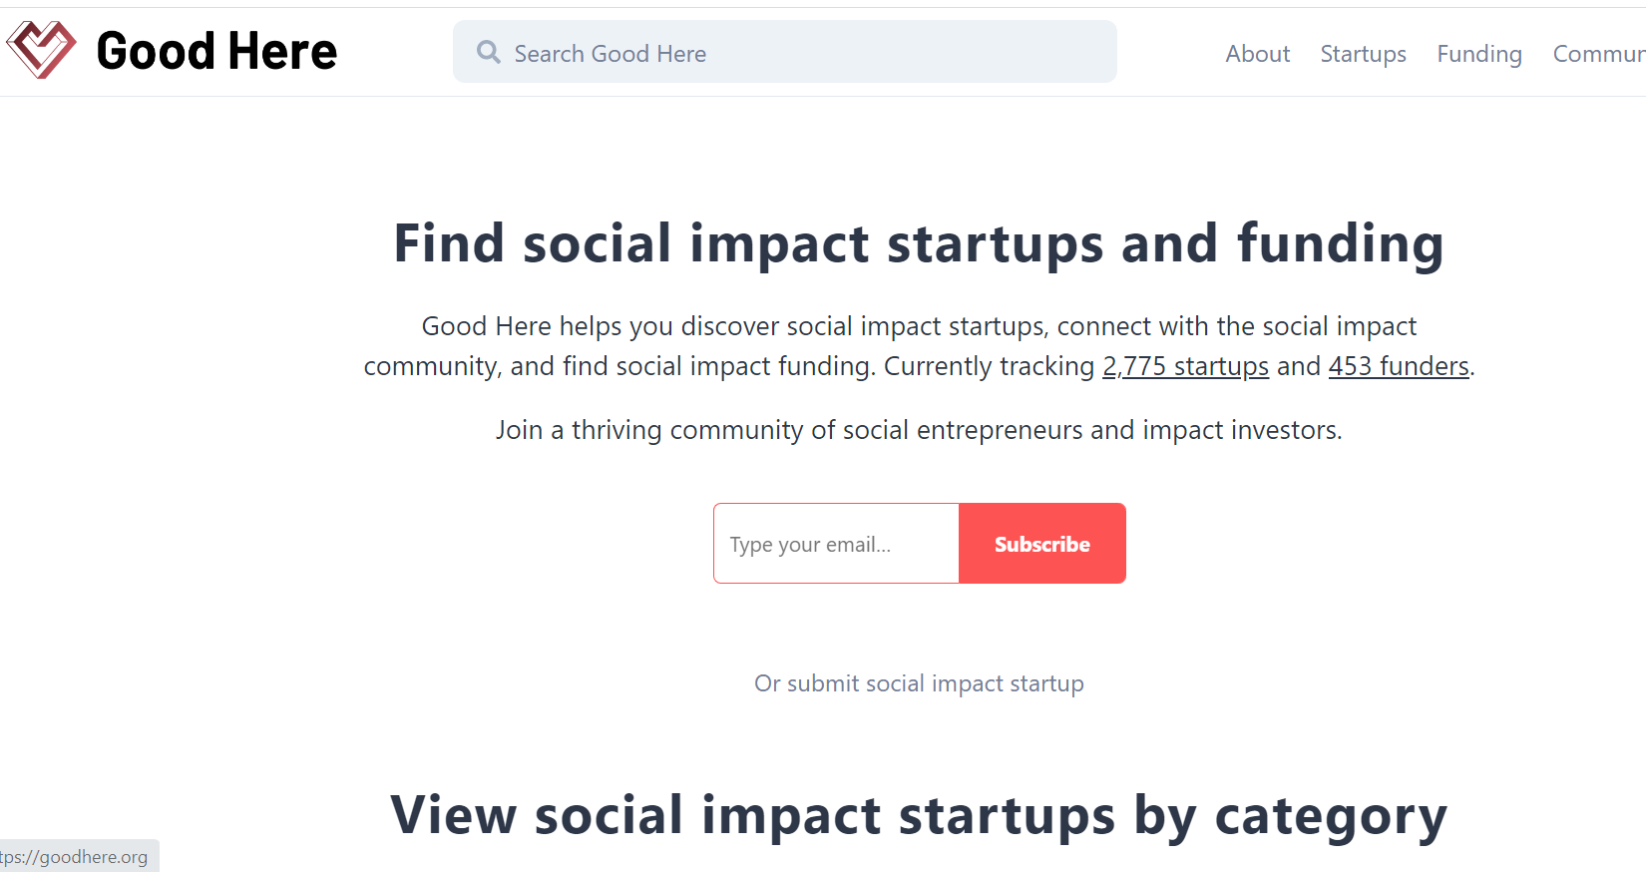
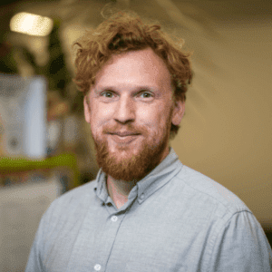
Good Here
Social Innovation Start Up Support and Finance
Co-Founder, Ben Matthews
‘Good Here is a global company that helps you discover social impact startups, connect with the social impact community, and find social impact funding. Currently tracking 2,775 startups and 453 funders’.
A thriving community of social entrepreneurs and impact investors.
Provide Grants, Crowdfunding, Incubators, Venture Capital, Accelerators, Prizes, Project Finance…

Slide 50
Interview with Young Digital Social Innovator
Full Interview
EXAMPLE YDSI - Care Across
Thanos Kosmidis, UK
A digital health start up focusing on the wellbeing of cancer patients.
Self Funded
Q1 How did you raise the money for your idea and what is your advice for others considering DIY fundraising?
The initial funding for the company came from our own funds. This was certainly challenging but it also helped us build high levels of discipline in our spending. If others are considering DIY fundraising, we would recommend having multiple sources of funds and a very concrete plan for spending the funds in general.

Slide 51
Interview with Young Digital Social Innovator
Gary Fawdrey
Progressive Careers, UK
Full Interview
EXAMPLE YDSI, Progressive Careers
Gary Fawdrey, UK
‘The Creation of Digital Social Impact in Unemployment’
Q1 How did you raise the money for your idea?
I haven’t raised any money for this initiative. I decided early I wanted this to exist because I thought that it should, it didn’t need money to run and I didn’t need money in order to work on it. This is of course though not always the case with social innovation projects.
Q2 How did you scale your social innovation?
I started initially with a focus on London (where I live), and through pairing mentees and mentors up one at a time. This ensured the workload was manageable. I then scaled through outreach to universities, which drove traffic to the site and increased the number of applications. In terms of tips for scaling I would say focus on ‘low hanging fruit’ first, the easy wins that will help you get established.

Slide 52
High Potential Start-ups (HPSUs), Ireland
If you do not qualify for the HPSUs don’t worry we can support you with other measures of funding and supports from your Local Enterprise Office
Our HPSU Team supports the development of a business with global ambition and a scalable business model that is capable of successfully competing internationally, has developed a differentiated and innovative product/service preferably through R&D, technology development, IP development.
The Supporting SMEs Online Tool is a cross-governmental guide to help small businesses know which of the over 80 Government supports could possibly fit their business.

Slide 53
EXAMPLE YDSI – Thriftify
We want to disrupt how and why people shop. Faced with ecological crises, we need to give people the option of purchasing from the most sustainable sources.
We also need to shift our value system from a materialistic basis to one driven by positive social impact. We want to help charity shops move from a €2 billion bricks and mortar-based industry to a €20 billion digital commerce-based industry.
Meet Rónán Ó Dálaigh, Rahil Nazir and
Timur Negru of Thriftify
Source: Irish Times

Slide 54
Partnering With Purpose:
The founders of Thriftify (an online ecommerce platform for charity shops) bring varying skills…
Ó Dálaigh studied Irish and business at DCU and was the driving force behind two previous social enterprise start-ups. Nazir studied computer science and has a background in software and digital transformation projects for large corporates. Negru studied business and law, followed by a master’s in digital innovation, and previously worked for Microsoft and Clavis Insight, where his focus was ecommerce analytics.
CASE STUDY
KEY TAKEAWAY: Don’t go it alone, partner with others for increased chances of success!

Slide 55
YDSI SPOTLIGHT ON
Social
Solutions For
Consumption
What is its social mission? thriftify is an online platform creating a movement of positive purchasing by connecting charity shops with consumers who care.
What was it founded on? the act of purchasing ethically and sustainably.
“When you thriftify, you're not just buying the most sustainable product, you're supporting good causes, turning your money into magic!”
More and more charities are now selling online with thriftify

Slide 56
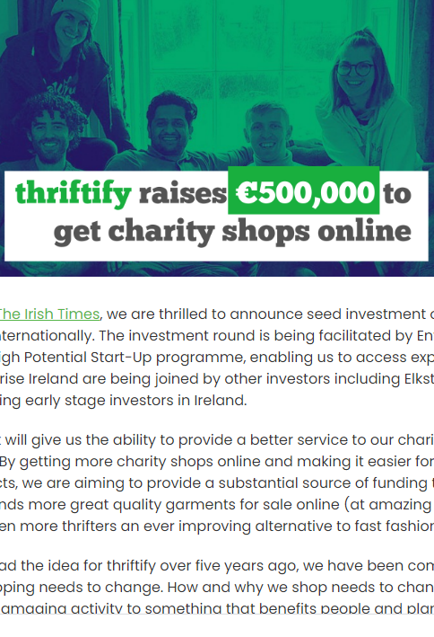
HPSU Local Enterprise Office Funding
Thrifty Raises €500,000 Investment
Facilitated by Enterprise Ireland through their High Potential Start-Up programme
‘The investment will give us the ability to provide a better service to our charity partners and to our thrifters. By getting more charity shops online and making it easier for them to list and sell products, we are aiming to provide a substantial source of funding to good causes. Getting thousands more great quality garments for sale online (at amazing prices) means we can give even more thrifters an ever improving alternative to fast fashion’.

Slide 57
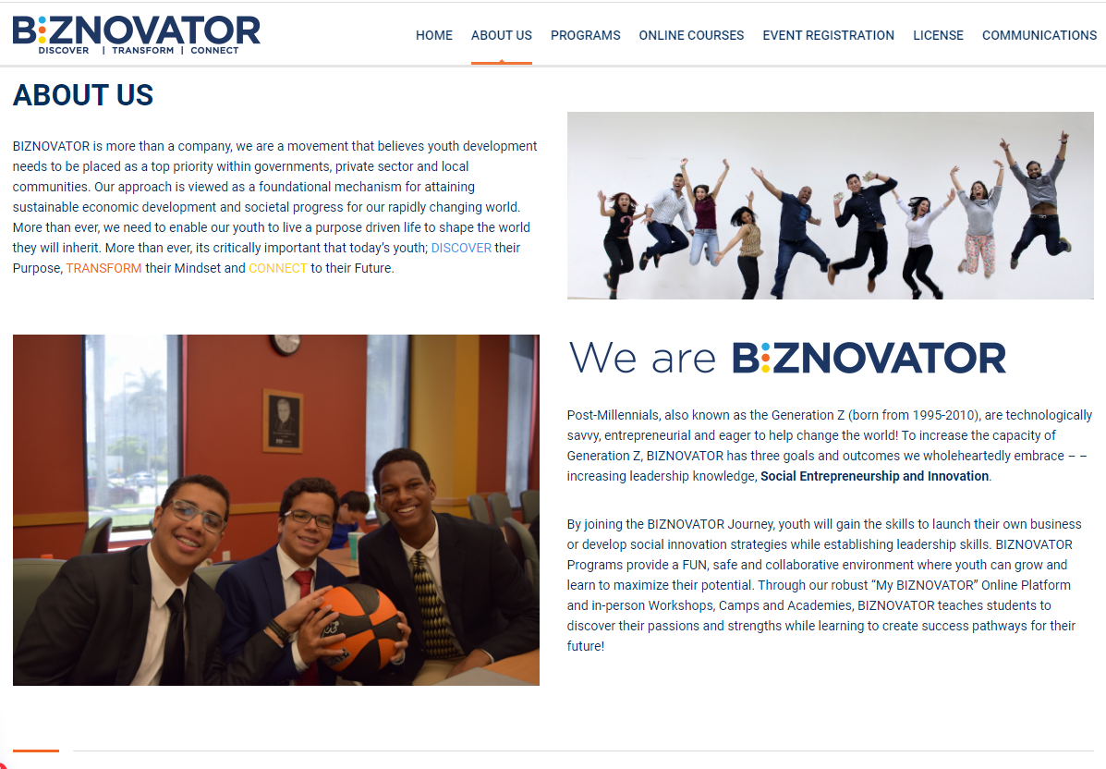
At BIZNOVATOR empowers and enables youth entrepreneurship, through social innovation and global leadership.
Their mission is to empower, teach and create young entrepreneurs, social innovators and global leaders who will positively impact their communities and the world. BIZNOVATOR nurtures Social Entrepreneurship and Innovation that equip youth to launch ventures with purpose. This is an initiative to enable young people to view entrepreneurship as a platform in order to bring a positive impact to their communities.
Biznovator
Discover – Transform - Connect

Slide 58
5. Challenge Prizes
Social Innovation Competitions, Grants & Awards – not only brings acknowledgement but funds too! Join their networks for support.
Challenge Prizes
European Level (EUSIC)
Challenge Prize Toolkit
Challenge Prizes can be a great tool to fund frugal innovations. The benefits from challenge prizes reach beyond the financial support to finalists and winners. Also winners get a rise in profile, access to a network of stakeholders working in the same area, community of innovators and the market. There are numerous throughout Europe…
The European Social Innovation Competition (EUSIC) is a challenge prize run by the European Commission across Europe
Challenge Prize Competition phases.
Phase 1: 30 semi-finalists are selected to receive mentoring support and further progress their ideas.
Phase 2: 10 finalists go to awards ceremony, three final winners are announced and received a prize of €50,000 each.
Winners of 2020 three projects, selected for addressing this year's challenge ‘reimagine fashion' received a prize of €50,000 each.

Slide 59
Resortecs, Belgium
Snake, Croatia
Challenge Prizes
Challenge Prize Winners 2020
resortecs® Belgian start-up that helps simplify the process of reusing and recycling textiles
Snake Croatian digital platform that enables users to wear outfits in augmented reality
WhyWeCraft: Cultural Sustainability in Fashion Romanian legal support mechanism for craftspeople and designers
WhyWeCraft, Romania

Slide 60
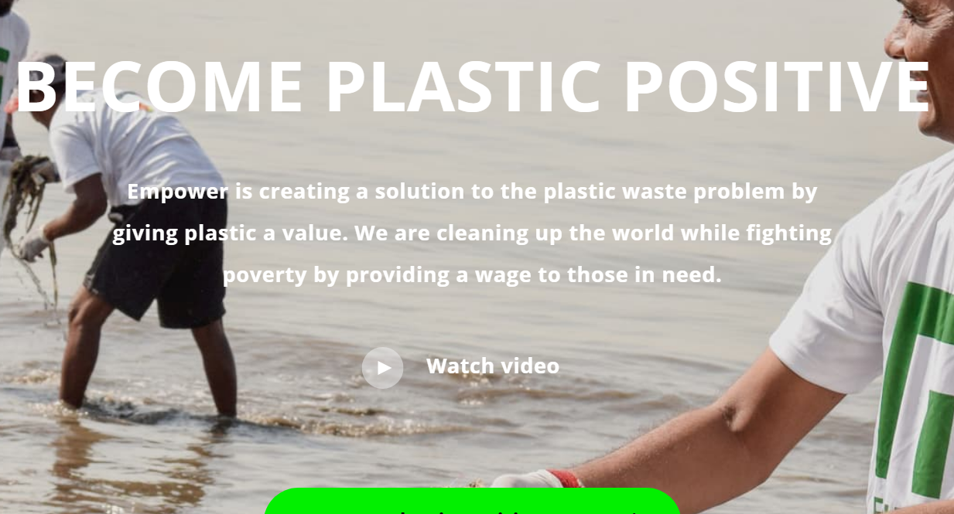
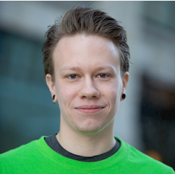
YDSI, Environment
Gjermund Bjaanes, Netherlands
Challenge Prizes
Overall Winner 2020, Empower
The 2020 winner is Empower, a company that adopted a new technology to enable circular economy, by allowing the deposit and collection of plastic waste for financial reward.

Slide 61
Other European Challenge Prizes
Challenge Prizes
Challenge Prize Toolkit
Right now, Digital Social Innovators can exploit the funding opportunities offered by the European Innovation Council (EIC) pilot. These include:
The Blockchain for Social Good Prize, where the challenge is to is to develop scalable, efficient and high-impact decentralised solutions to social innovation challenges leveraging Distributed Ledger Technology (DLTs)
The Affordable High-Tech for Humanitarian Aid Prize, where participants are called to develop innovative solutions for the delivery of humanitarian aid based on frugal application of advanced technologies
The European Commission’s Horizon Prize for Social Innovation will reward the best solutions for improving the travel mobility of older people.

Slide 62
Get Ready to Craft Your 3 Min Pitch to Your Potential Investors
In this section we will go through Social Innovation Pitching Tips targeted at potential investors. You will learn how others impressed Dragons with their pitches and the value received.
At the end there is an exercise with some fine tuning videos for you to start developing your 3 minute pitch as an individual or a team.

Slide 63
Social Innovation Pitching to Investors
Use These Ideas To Craft A Compelling Pitch To Boost Awareness And Secure Funding For A Social Venture.
Pitch Tip 1 Know Your ‘Investment Story
Pitch Tip 2 Know Your Audience
Pitch Tip 3 Balance Vision And Details
Pitch Tip 4 Balance Stories And Figures
Pitch Tip 5 Clearly Show How You Create Value
Pitch Tip 6: Highlight Team Experience + Credibility
Pitch Tip 7: Stand Out
Pitch Tip 8: Use Visuals To Support Your Message
Pitch Tip 9: Be Clear And Concise
Pitch Tip 10: Don’t Shy Away From Financials
‘Then Practice, Practice, Practice’
Read Further here

Slide 64
Teens Impress Dragons at YSI Virtual Den, Ireland
Took place over the course of 3 days, 25 teams across Ireland pitched to the Den Panels. YSI was able to supply teams with some €10,000 in funding as well as means and mentoring to support their projects. This Social Innovation Fund is made available every year by YSI to help bring young people's ideas to life.
Den participants addressed a wide range of issues including mental health, body positivity, road safety, equality and the environment.

Slide 65
Teens Impress Dragons at YSI Den, Ireland
Our team has thought deeply about how our project will impact people both now and into the future. We feel that education is one of the most powerful tools to use. We plan on educating young children on why everyone should be treated equally by promoting diversity and explaining equality in a fun and simple way so they can understand. By living in a more equal world, it means people feel safe, accepted and are able to live their best life and reach their full potential without others dragging them down.
Zara Notley, YSI Team Member - Newtown School, Waterford
Students from Newtown School, Waterford secured €550 in funding to develop their project aimed at educating primary school children on issues relating to inequality and discrimination. The Waterford teens plans to create a children’s book and accompanying diverse doll to help communicate their message of diversity and inclusion to a primary school audience. They also plan to create a podcast in order to promote their message of equality to a wider audience.

Slide 66
EXERCISE
3 Minute Pitch to Investors
Watch these videos and based on the tips provided in the previous slide work ether with your team or alone to develop a 3 min pitch
These video combines lessons learned and how to stand out and shine….
How to Pitch a Start - up in 3 Minutes
Want to learn the most common mistakes when pitching?
How to Create a Pitch Deck for Investors

Slide 67
Next Module 6
Mission Marketing and Story Telling as a Powerful Way to Launch and Market Your Social Innovation Project
email
website

