Slide 1
Module 4
Digital Social Innovation
Driving Your Business Forward and Creating Partnerships with Purpose

Slide 2
Overview of all 6 Modules
Module 1 Digital Social Innovation Introduction - the potential at the intersection of technology and new media
Module 2 Where are the opportunities for young people? Social issues solutions in health, democracy, consumption, money, transparency, and education
Module 3 Mastering and Implementing Design Thinking
Module 4 Driving Your Business Forward and Creating Partnerships with Purpose
Module 5 How to Finance and Fund Your Digital Social Innovation Idea
Module 6 Social Innovation Mission Marketing – Reaching Hearts and Minds
WELCOME
How to use these Modules! These Modules can be adapted, modified, shortened or combined however you think they will work best for you and your students learning. Please respect copyrights, branding and acknowledgement that these resources and materials were developed by Young Digital Social Innovators with the funding and support of the Erasmus+ European Commission.

Slide 3
Module 4 Topics Covered
What you need to maximize the impact of your digital social innovation project and drive it forward!
How to set up a digital social innovation project or business This section you will learn how to set up your start up beginning with the most important decisions first and directing you to your first business meeting – with your local enterprise board!
Partnerships with Purpose Learn how to advance your project by joining or networking with some of the most dynamic and creative innovations spaces across Europe
Accessing Resources, Supports and Tools To help you drive your business and savvy idea forward in an innovative way
Overview

Slide 4
Module 4 Learning Objectives
Take action – build on the steps involved in setting up a digital social innovation project or business
Understand how you don’t have to go through it alone – how there are multiple different types of spaces across Europe both on/offline to talk out and overcome the obstacles to your digital social innovation idea. There are experts there that can support you in an affordable way.
Become inspired as you learn how other inspiring young people built their game changing initiatives with the support of Incubators, Accelerators…
Learn how to develop your idea by getting advice, thoughts and feedback from collaborative networks and potentially your classmates. How to bring your crazy and potentially world changing idea to life!

Slide 5
Introduction to Module 4
In this Module you will learn how to set up your digital social innovation project and then drive your project forward through collaboration and creating partnerships with purpose. Module 1 and Module 2 were designed to inspire and ignite your social innovation passions and ideas. Module 3 builds on this by offering five actionable phases (Empathize, Define, Ideate, Prototype and Test) to guide you in developing your social innovation mission.
In Module 4 you will learn how to get started and to use the different and relevant support systems in your communities in terms of business and social innovation, how to work within partnerships, pool resources, get the most out of networking and volunteering and attracting resources.

Slide 6
How to Set up a Digital Social Innovation Business
So you have your idea in place. You are ready to start your online digital social innovation business. Trading online can involve selling a product or service, or offering an online booking platform. How you trade online will depend on your business offering so some of these steps may not be relevant to everyone.
This section will get you started in setting up your business and point you in the direction of the best supports in the sector.
In the beginning, you may consider starting an online business at the same time as working a full-time job or going to school. But it’s important to understand that you need to register the business with Revenue and the CRO and look after the compliance requirements. Go to your local enterprise office to get all the information you need for your respective area in your respective country. From an Irish perspective Compliance Requirements for a New Company in Ireland

Slide 7
STEP 1 Decide How You Want to Sell or Distribute Online
Will you set up your own website, use a reseller platform like Amazon or eBay, or a mixture of online sales and offline sales?
Consider writing a business plan and doing research on what option is best for you. Writing a business plan will help you narrow your target audience and determine what your customers expect from your site. You should ensure you can meet your customer’s expectations.
Shopify and Squarespace offer templates for new e-commerce businesses. They’re easy to use and easy to manage.
Wix or WordPress are really affordable, easy to set up stunning website platforms with loads of development and marketing tools.

Slide 8
STEP 1 Decide How You Want to Sell or Distribute Online
Will you set up your own website, use a reseller platform like Amazon or eBay, or a mixture of online sales and offline sales?
There are also great tools online that help you manage your business. Google Workspace is a collection of cloud computing, productivity and collaboration tools, software and products for businesses and projects. Everything you need to get work done in one place. Shared drives, shared calendars, business email, video conferencing, interactive online forms…
Get started here

Slide 9
STEP 2 Contact Your Local Enterprise Office
Speak to expert mentors and professionals who are provided by local government
Organise a meeting with your Local Enterprise Office. They will be pivotal throughout your start up development and provide you with the best information and support you need to set up your business.
They provide direct financial supports with 10 employees or less.
They advise on funding options and business plan development.
They offer business information, advisor services and enterprise support.

Slide 10
STEP 2 Contact Your Local Enterprise Office
Speak to expert mentors and professionals who are provided by local government
They offer high quality training in Start Your Own Business, Managing Your Business e.g. Marketing, Sales, Financial Management, Strategy and Business Planning.
They will show you how to register with your local tax office, tell you what you are entitled to, invite you to enter in prize winning competitions (often funding), refer recommended ways to do your accounting and so much more.

Slide 11
STEP 3 Sole Trader or Limited Company
Starting an online business means you need to officially register with Revenue and the Companies Registration Office (CRO)
Decide what business structure you want to be – Sole Trader or Limited Company. There are advantages and disadvantages to both business types.
Sole Traders take on more risk than Limited Companies. They are personally liable for the debts of the business therefore you may need to sell personal assets to repay debts.

Slide 12
STEP 3 Sole Trader or Limited Company
Starting an online business means you need to officially register with Revenue and the Companies Registration Office (CRO)
On the other hand, setting up a Limited Company may be the right option because the registration process creates a separate legal entity. This provides more security for you as you have limited liability as a company.
Register your company with your national Companies Registration Office (CRO)
Module 5 will cover funding and financial supports in more detail
Module 6 will cover marketing specific to social innovation

Slide 13
STEP 4 Register with Tax Revenue
Starting an online business means you need to officially register with Revenue and the Companies Registration Office (CRO)
Both Sole Traders and Limited Companies need to pay tax so it’s important you register for tax before you start selling online. Sole Traders register as self-employed and Limited Companies register for tax with Revenue.
The amount of tax you pay depends on the size and type of your business and what sector you belong to. So each business may require different tax registrations. You should always seek an accountants’ advice to ensure you comply with your obligations as an online business.

Slide 14
STEP 5 Collaborate and Get Support in Digital Social Innovation Hubs and Networks
You are at the beginning of your exciting project or business. You have the basics covered in setting up a business. Before you starting putting your feet firmly on the ground and setting things in stone you are going to need support specific to setting up a Digital Social Innovation business. Throughout the remainder of this module we will take you through how these amazing groups, hubs and networks can ignite your spark and help you move your digital social innovation business forward in the best direction possible!

Slide 15
STEP 5 The Power of Collaboration
As you now approach your project with a renewed sense of purpose and direction it is worthwhile considering collaborating with others before you dive into ideas and solutions. Remember that only 20% of ideas are viable – so, for this reason alone, by not fully investigating the problem you limit your chance for success.
If you focus on the problem with collaborative support you are more likely to unlock a solution that is a gamechanger. It is with these networks and communities you can dig deep and get to the root of the problem(s) and discover the often-unlikely solutions and collaborations that truly make a difference.

Slide 16
The Power of Being Part of a
Space for Innovation
The examples presented in the following sections will show you where you can access different physical and digital spaces that allow creativity and innovation.
Imagine you are in an environment with similar people in the same field with equally great ideas, it can be in person or online, and working together on some of the best Digital Social Innovation ideas yet….
These spaces come in all shapes and sizes from Incubators, Accelerators, Programmes, Living Labs, Makerspaces….all enriched with learning, support and understanding of how places, people and innovation can interact to become a reality in an affordable way….

Slide 17
The Power of Being Part of a
Space for Innovation
All the spaces and supports in this Module focus on forming collaboration that enables groups of young people, stakeholders and investors to cultivate connections across communities and organizations, and to strengthen a whole system simply by focusing on the potential for participants to share information and learn from one another.
Expect to form deeper connections and gain a shared learning result. To drive your business forward they will provide you with a dedicated network of coordinated support and access to specific networks you need to connect to that suit your business venture. You will have access to a wealth of expertise and information, learn processes, ways of doing business that suits your YDSI Idea.

Slide 18
What are Incubators?
Incubators can be defined as; “...a shared office-space facility that seeks to provide its ‘incubatees’ with a strategic, value adding intervention system of monitoring and business assistance.”
Over 60% of incubator tenants say the incubator is critical to business performance!
Incubation or incubators can have a positive impact on a business’ development and provide start-ups with ‘life support’. They provide new businesses with credibility
By being part of an incubation business development, support and mentoring
Through access to professional facilities
Provide access to resources and talent – legal help, for example.

Slide 19
What do Incubators provide?
Supportive and learning environment – marketing, Business Plan development, IT, government regulations…
Provide a space for integration and learning through workshops and programs e.g. R&D
Create opportunity for technology transfer.
Can pair you with other companies that can help you
Create and capitalise investment opportunities
Provide Faculty-Industry collaboration
Access to facilities
Assist with applying for grants, funding and awards

Slide 20
What are Accelerators?
They are similar to Incubators providing new models for starting and funding a business. One of the world’s first seed accelerator programmes – which is often credited as having sparked the wider accelerator movement – is the Y Combinator. This programme provides advice, access to networks and seed funding in exchange for an equity stake (typically $120k for 7 per cent). It has helped to develop more than 1,400 technology companies, including many now-familiar firms such as Dropbox, Airbnb, Coinbase and Reddit.

Slide 21
How do Accelerators Work?
The accelerator provides features that set it apart from other approaches to startup investment or business supports. These include:
A selective admissions process mainly for start-ups
Providing mentoring or business training with a focus on classes rather than teaching individually.
Intense and time-limited support, usually lasting between three and 12 months.
Accelerators are funded and often tend to focus on supporting technology-based or digital start-ups.
Encourage a high degree of peer-to-peer learning, so members can learn from each other
Funding is provided (sometimes in exchange for equity), a workspace, facilitated networking, educational seminars/workshops and other services

Slide 22
Accelerators – a key opportunity to advance your project
Ideas often need incubation in a protected, supportive dedicated social innovation environment that provides resources, support, advice and freedom to evolve
Accelerators are educators, enablers and highlight the critical role played by the ‘connectors’ and ‘connecting’ and ‘collaborating’ in any innovation system is highly valuable – bringing together - the brokers, entrepreneurs and institutions that link together people, ideas, money and social innovation power – who contribute together to lasting change as thinkers, creators, designers, activists and community groups.

Slide 23
Dedicated European Social Innovation Spaces
This section will introduce you to different Social Innovation Accelerators that have different approaches.
Cibernarium, Barcelona, Spain (Training Focus) provides digital and technology training for all levels
Ashoka, Ireland and UK (Networks & Community building) cultivates a community of change leaders
Skoll Centre, School for Social Entrepreneurs, Oxford University, UK (Scholarship Program) - support and inspire students to tackle world-scale problems through social entrepreneurship

Slide 24
Dedicated European Social Innovation Spaces
The Young Foundation, UK, are a leading centre for supporting and incubating social innovation; creating new enterprises, ideas and solutions to tackle some of our most pressing problems. The provide insights, programs and design impact investment funds.
5. Nesta Accelerator Program, UK provide intensive and time-limited business support for cohorts of social innovation startups, aiming to get them ready for investment more quickly than traditional incubators.
Conservation X Labs The Digital Makerspace (DMS) Is An Open Online Project Platform Where Entrepreneurship, Conservation, and Technology Communities Come Together To Collaborate On Solutions To End Human-induced Extinction

Slide 25
1. Cibernarium, Barcelona, Spain
A place Barcelona City Council have set up that drives digital talent and offers free technology training for everyone at all levels.
A place where young people can access improve their digital skills in social innovation. Cibernarium is a a technology training centre for improving the digital skills and technological knowledge of citizens, professionals and local businesses through 180 different short and medium duration activities, practical work and learning sessions. They provide all levels of technology training for everyone (Basic, Specialised, Advanced) and even foster scientific and technological vocations. They teach ICT, Digital and 3D Manufacturing to Web Design.

Slide 26
2. Ashoka, UK & Ireland
Community of Young Changemakers
Ashoka uses 3 main approaches;
Social Entrepreneurship: selects world class social entrepreneurs who are leading the way to an everyone a changemaker world.
Empathy & Young Changemaking: leading a movement to transform how young people can thrive in today’s rapidly changing world where everyone must be a changemaker. Changemaking starts with empathy!
Organising for Changemaking: Living and working in our changemaker world requires breaking through silos, tearing down walls, and organizing in fluid, open, teams of teams.
‘Ashoka builds and cultivates a community of change leaders who see that the world now requires everyone to be a changemaker. Together we collaborate to transform businesses, ideas and cultures so that they support changemaking for the good of society’.

Slide 27
Ashoka, UK & Ireland
‘Ashoka launched the UK’s first Changemaker Region in Manchester. More than 250 participants joined the conversation…’.
Community of Young Changemakers
Explore and Get Connected to the Ashoka, Changemaker Community with 3,500+ Fellows, 250+ change institutions, and 300+ partners across more than 90 countries. Together, we form a strong, diverse and vibrant ecosystem of change agents collaborating and co-leading to positively transform societies and cultures around the world. Learn more about our changemaker community
Meet one of our members Sarah Zouak in the next section!!

Slide 28
3. Skoll Center, UK
Support and inspire students to tackle world-scale problems through social entrepreneurship, from education to climate change, from poverty to healthcare. We offer a rich portfolio of programmes and events, opportunities for funding and financial support, as well as a range of collaborative opportunities.
We also work to advance the field of social entrepreneurship through research insights and knowledge exchange. We are in a unique position to bridge the gap between theory and practice.

Slide 29
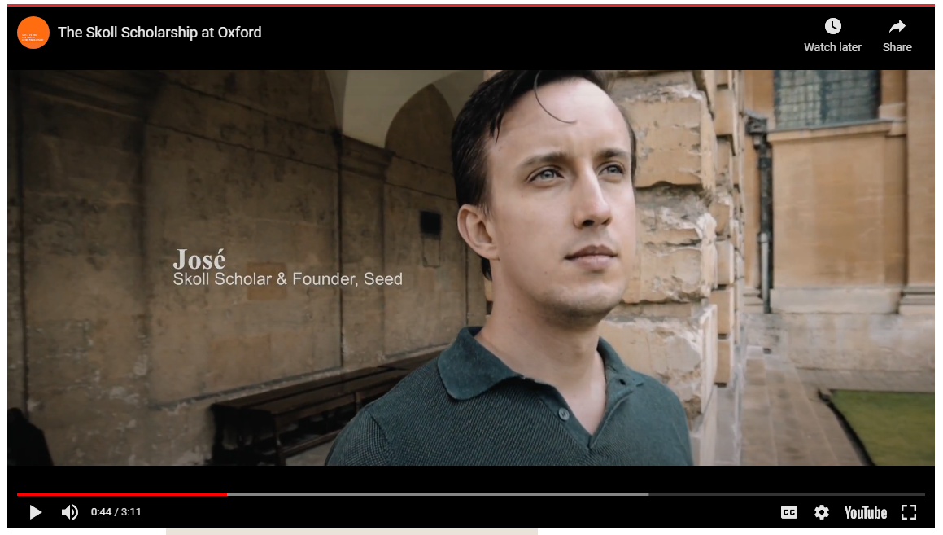
Skoll Centre, Full Scholarship Students
Skoll Centre, Full Scholarship Funding Opportunity
The Skoll Centre for Social Entrepreneurship as a leading centre for the advancement of social entrepreneurship worldwide offer a scholarship open to students pursuing entrepreneurial solutions for urgent social and environmental challenges. Providing full funding, the Scholarship also provides access to the Skoll Scholar community, a group of leaders who are positively impacting the world through innovation and systems change, as well as exclusive opportunities to meet with world-renowned entrepreneurs, thought-leaders and investors.

Slide 30
4. The Young Foundation, UK
Our mission is to develop better connected and more sustainable communities across the UK. We provide programs (e.g. health and wellbeing and inequality) insights, work with communities and provide funding.
Conduct research on both the theory and practice of social innovation
Have a proven accelerating curriculum for social ventures
Design and manage impact investment funds; in partnership with government and commercial organisations
Offer the physical space and back-office support
Offer consultancy services and work in partnerships to explore new innovation models
Young Foundation are a leading centre for social innovations that support a more just society. We work with the public, private and voluntary sectors and in communities to strengthen their ability to effect change. Bringing together a broad range of approaches and expertise

Slide 31
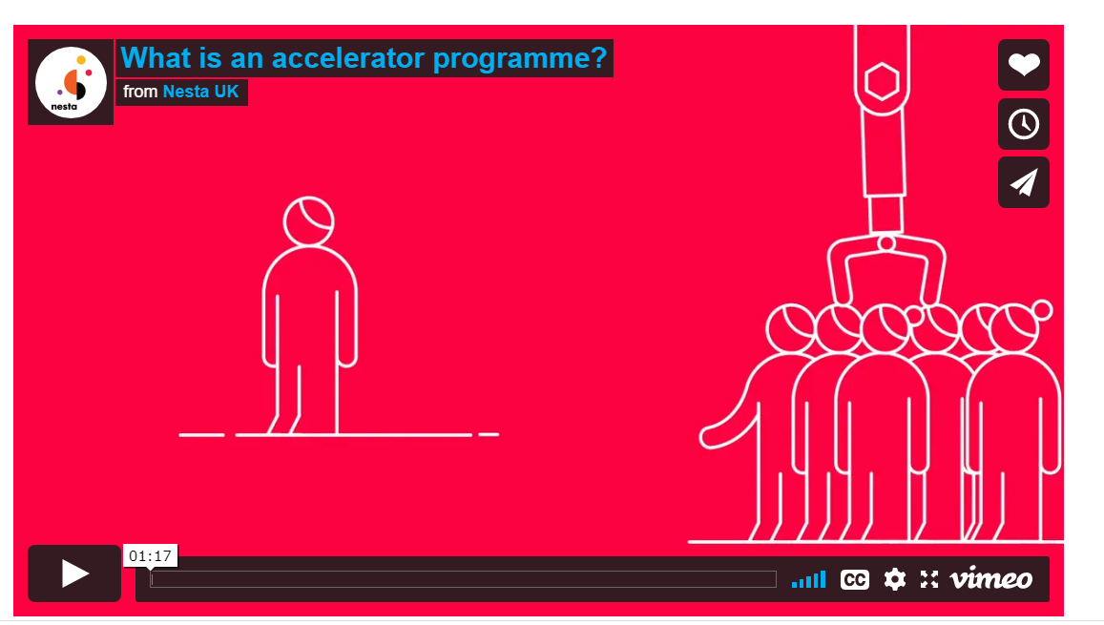
5. Nesta Social Innovation Accelerator Programs
Nesta makes early investments in a range of start-up incubators, from Seedcamp to Springboard, the European Microelectronics Academy to Design London. It all started in 2011 with The Startup Factories, which charted the rise of accelerator programmes supporting new technology ventures in the US and Europe. Nesta have created the first ever map of accelerator programmes across Europe.

Slide 32
Nesta are dedicated to understanding how to improve targeted incubation and acceleration for social ventures. They have analysed the emerging trend in social impact accelerator programmes in Good Incubation
Startup Support Programmes: What’s The Difference (2015) explains how accelerator programmes differ in how they make money and when they intervene in the startup journey.
Business Incubators and Accelerators: the National Picture identifies where accelerator programmes are located throughout the UK and what sectors they focus on.
Nesta is one of several founding partners in the Accelerator Assembly, a network of accelerators across Europe. Part of the European Commission’s Startup Europe initiative, it aims to enable research, share information, and improve the transparency of programmes.
Nesta
Dedicated to Providing Innovative Methods and Accelerator Programs Across the UK and Europe

Slide 33
Bethnal Green Ventures (BGV) is an accelerator programme with a mission to develop tech-based solutions to the world’s social problems. It evolved out of Social Innovation Camp – a competition event co-funded by Nesta and the Young Foundation – that brought together software developers and designers with people who understood social problems. Bethnal Green Ventures launched in 2011 and was one of the first social accelerators in Europe. Full Interview
Why does Bethnal Green Ventures focus on social innovation? How has Bethnal Green Ventures evolved over the past three years? How do you support such a varied range of start-ups?
What BGV start-ups are you most proud of?
Good Gym helps people stay fit by ‘running’ errands for the community has done really well.
Fair Phone is the biggest financial success. Everyone said it was impossible to create a smart phone with ethical materials.
DrDoctor has built smart appointment apps for hospitals’ outpatient departments.
Nesta
Bethnal Green Accelerator Program
Full Interview

Slide 34
Toolkits
Startup Accelerator Programmes: A practice guide (2014)
Reports
A Look Inside Accelerators (2015)
Business Incubators and Accelerators: the National Picture (2017)
Good Incubation (2014)
Incubation for Growth (2011)
Startup Support Programmes: What’s the difference? (2015)
The Startup Factories (2013)
Blogs Incubators and accelerators: An updated directory for the UK (2017)
Projects and partners; Digital Arts and Culture Accelerator, Bethnal Green Ventures, Accelerator Assembly
Nesta
Further Resources…

Slide 35
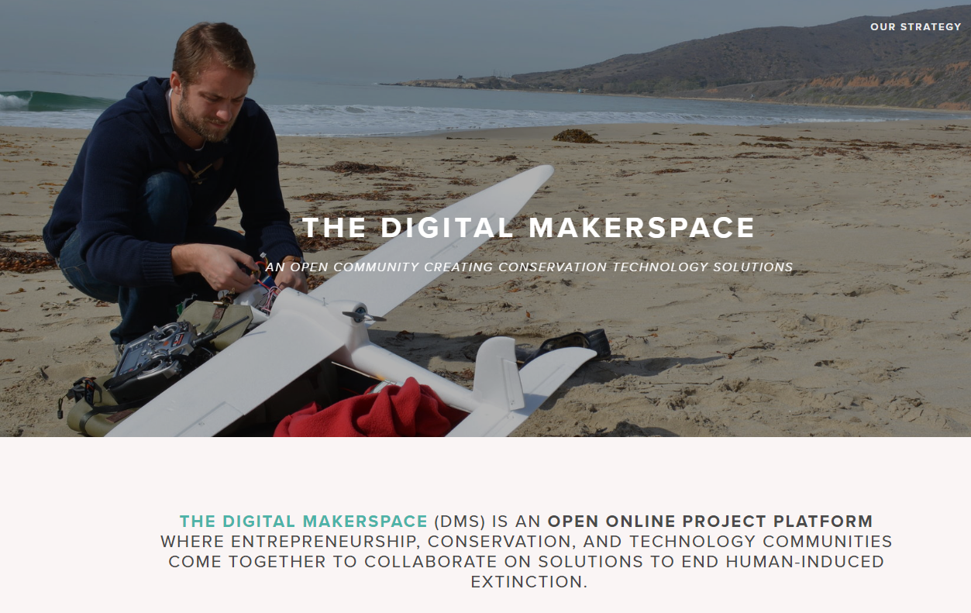
6. Conservation X Labs
The Digital Makerspace
The Digital Makerspace (DMS) Is An Open Online Project Platform Where Entrepreneurship, Conservation, and Technology Communities Come Together To Collaborate On Solutions To End Human-induced Extinction
The DMS is a collaboration space and project pipeline where ideas for tech-enabled solutions to conservation problems can be born, tested, and developed. We believe that open innovation, collaboration across disciplines, and community engagement are key to generating world-changing ideas, and that many minds working together can refine them and achieve big things.

Slide 36
On The Digital Makerspace, You Can:
1
Respond to a Challenge in the Challenge Browser - a list of some of the most wicked problems facing the planet including our active prizes & challenges.
2
Join a project with the Project Browser - the full list of 150+ inspiring projects being built by the Digital Makerspace community.
3
Post a new idea in the Ideas Bin - get thoughts and feedback from the community about your crazy and potentially world-changing idea.
4
Discuss a tough problem in the Problem Bank - a space to talk out the obstacles in conservation, and see which ones we can solve.

Slide 37
The Digital Makerspace Opportunities
Example Project
Zoohackathon: Coding to End Wildlife Trafficking
In 2018, Zoohackathon held their annual world-wide hackathon, bringing software developers from San Diego, Madrid, Uganda, Mumbai, and New Delhi together for 48 hours to develop innovative open-source solutions to wildlife trafficking. Conservation X Labs partnered with them to run the event on the Digital Makerspace.

Slide 38
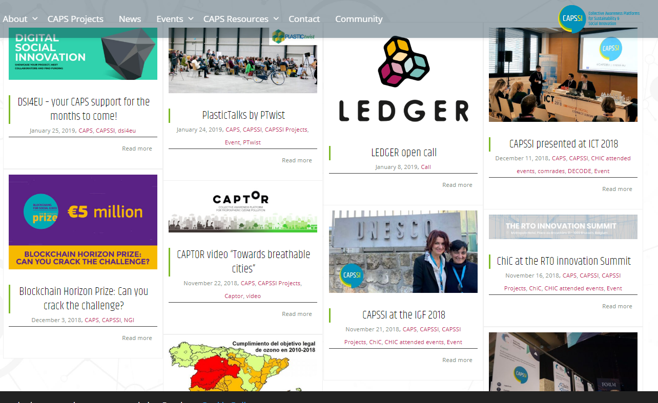
Networks & Platforms
for Digital Social Innovation
Collective Awareness Platforms for Sustainability & Social Innovation (CAPSSI) offer ICT systems leveraging the emerging « network effect » by combining open online social media, distributed knowledge creation and data from real environments (« Internet of Things ») in order to create awareness of problems and possible solutions requesting collective efforts, enabling new forms of social innovation. The CAPS Community is a place to share experiences, knowledge, ideas, and happiness, co-create ideas and content, meet the actors of CAPS and share your news & events.

Slide 39
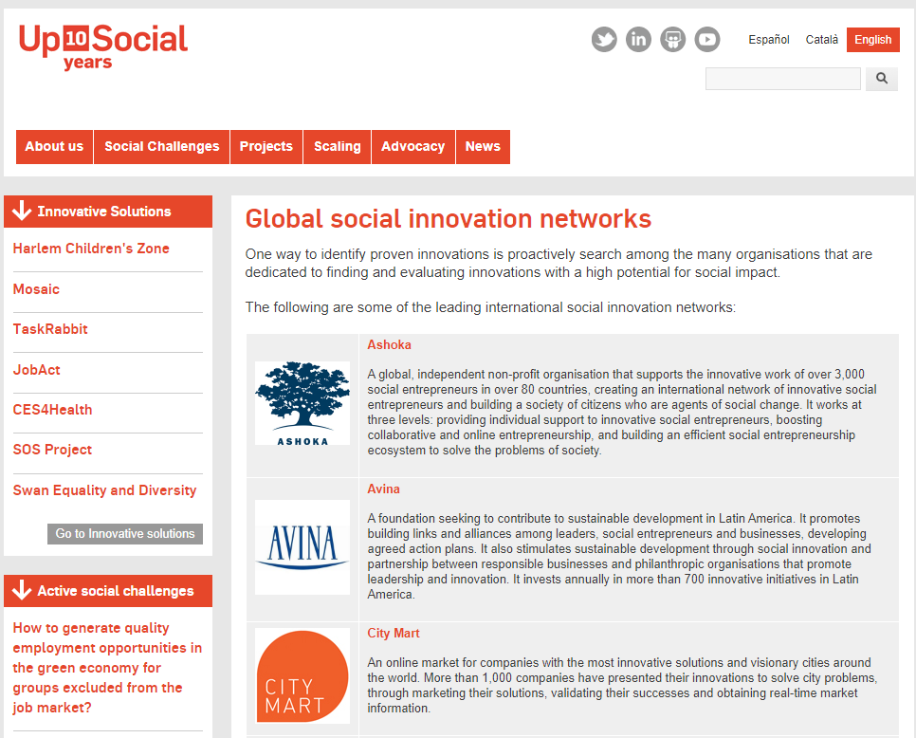
Networks & Platforms
for Digital Social Innovation
Collaborative Networking provides opportunities to work together, pool resources, allow volunteering and attracting resources.
Upsocial has global social innovation networks dedicated to finding and evaluating innovations with high potential for social impact.

Slide 40
EXAMPLE – an accelerator success story
Patrick and John Collison, STRIPE
“We wanted to make sure that we only make money if you make money. It’s a messaging challenge for us to explain to people that they’re paying more for their credit card processing then they think,” Collison said.
‘Stripe aims to give developers the tools they need to create the most secure and novel buying experiences’ said Patrick Collison, CEO and co-founder of Stripe. “Our partnership with Visa will accelerate our ability to expand to markets around the world, and give developers even more control over the end-to-end experience. We’re very excited about the potential’.

Slide 41
Y Combinator Was Instrumental to their Success
The Collison Brothers and the Story Behind the Founding of Stripe
The Irish-born brothers are a couple of the world’s youngest self-made billionaires. Patrick and John dropped out of MIT and Harvard, respectively, and sold their first business—an online auction management company—for a reported $5 million in 2008. Then they embarked on the idea that would become Stripe, now a payments behemoth valued at $9.2 billion. The company processes tens of billions of dollars in digital commerce transactions each year, inking deals with the likes of Amazon, Lyft, and Facebook

Slide 42
Example of How Y Combinator Helped
The Collison Brothers and the Story Behind the Founding of Stripe
The first funding came from Y Combinator!
The amount YC invested was in the $20k-$30k range. That next summer they met with Peter Thiel after he spoke at a YC dinner, and the founder of PayPal offered his insights into the Payments market and his learnings from PayPal. After their meeting he offered to invest. They raised $2MM and added other usual Silicon Valley suspects like Michael Moritz and Sequoia Capital, Andreessen Horowitz, and SV Angel.
“Elon and Peter have been very insightful,” Patrick says. “They have sharp opinions on what PayPal did right and wrong. They have deep appreciation for how difficult it is to get there. They fought this battle for many years and it’s really helpful to have someone who can talk about the future in 15-years, but also someone who can empathize and sympathize with the day-to-day considerations. I don’t think there are that many people who can straddle both sides of that. “

Slide 43
Full Interview with Stripe, The Story Behind the Founding of Stripe and How Important Y Combinator was to their Success
I doubt that Stripe would have worked without YC. It’s that simple. Acquiring early customers, figuring out who to hire, closing deals with banks, raising money – YC’s partners were closely involved and crucially helpful.”
Patrick Collison, Founder, Stripe (YC S09)
But this adventure has humble beginnings. It took over three years of building their company Stripe.
In 2005 at the age of 16, Patrick Collison was the recipient of the 41st Young Scientist of the Year for his work with Lisp. His brother and co-founder John Collison scored the highest-ever score received by a student for the Irish Leaving Certificate. Before Patrick’s last year of school he left early to attend MIT. Click for full interview…

Slide 44
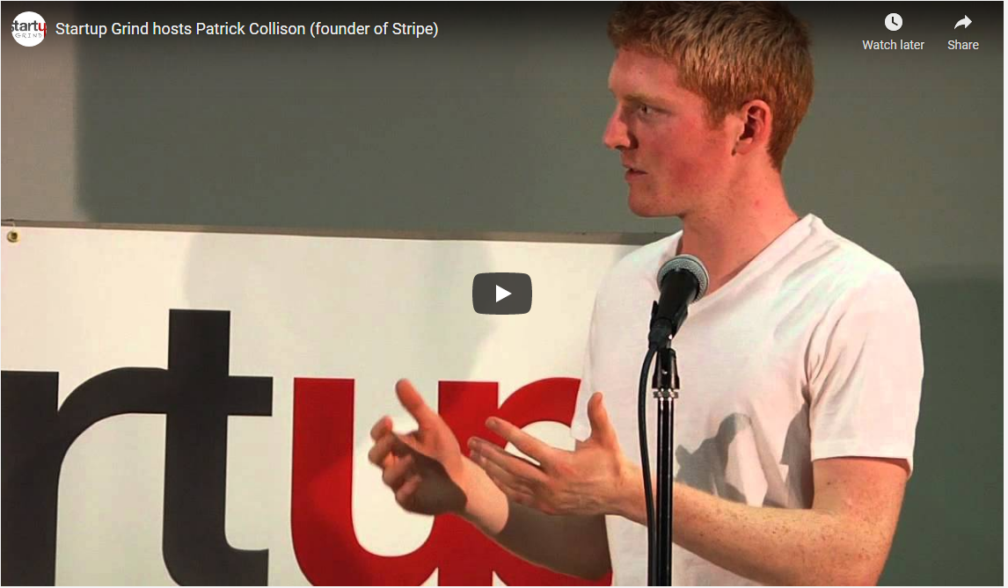
EXAMPLE YDSI – Stripe, Ireland
Patrick and John Collison
Patrick Collison, Founder & CEO of Stripe
Catch the full video interview here or see more live sessions with Patrick Collison of Stripe over their 3 years.
See the his fireside chat with Colleen Taylor of TechCrunch at the 2015 Startup Grind Global Conference

Slide 45
What are Living Labs?
Living Labs (LLs) are defined as user-centred, open innovation ecosystems based on systematic user co-creation approach, integrating research and innovation processes in real life communities and settings.
A living lab, or living laboratory, is a research idea, where what is studied is based on the user, logical approach, open-innovation environments, often researching based on a geographic location, looking at different research and innovation processes happening at the same time within a public-private-people partnership.
LLs use a collaborative system that empowers learners and researchers to design, develop and implement in an open, innovative, real-life environment. Often users are studied, experiments happen and as a result new solutions are developed
LLs work with people, research organisations, companies, cities and regions for joint value co-creation to help innovation and businesses.

Slide 46
The European Network of Living Labs (ENoLL) was created in the Unit “Collaborative working environments” The original concept was updated to open innovation environments attracting inwards investment, both intellectual and financial one.
ENoLL provides co-creation, user engagement, test and experimentation facilities targeting innovation in many different domains such as energy, media, mobility, healthcare, agrifood, etc.
ENoLL is well placed to act as a platform for best practice exchange, learning and support, and Living Lab international project development.
The European Network of Living Labs (ENoLL)
‘ENoLL counts today over 150+ active Living Labs members worldwide (440+ historically recognised over 14 years) and it is present in five continents in addition to Europe’.

Slide 47
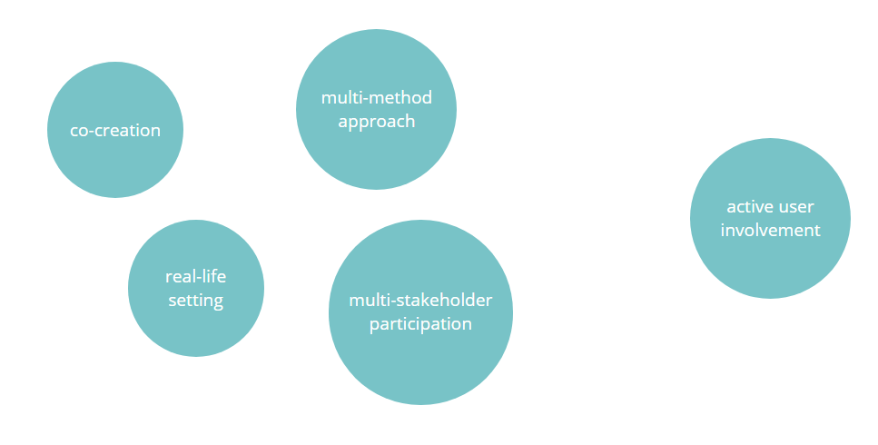
The European Network of Living Labs (ENoLL)
‘ENoLL counts today over 150+ active Living Labs members worldwide (440+ historically recognised over 14 years) and it is present in five continents in addition to Europe’.

Slide 48
Makerspaces & Fab Labs
A Makerspace is a collaborative workspace equipped for making, prototyping and digital fabrication. It is a space that offers space, learning, tooling and socializing around the practice of making, and also hacking and tinkering.
A Fab Lab is a kind of makerspace that follows rules and is governed by a foundation. It offers the same inventory at each of the 2000+ independently run spaces in the world to enable a user to be able to ‘make almost anything, anywhere.’ They are forms of digital fabrication spaces.

Slide 49
Makerspaces
FabLabs
Further Reading
A Makerspace is a collaborative work space inside a school, library or separate public/private facility for making, learning, exploring and sharing that uses high tech to no tech tools. These spaces are open to kids, adults, and entrepreneurs and have a variety of maker equipment including 3D printers, laser cutters, cnc machines, soldering irons and even sewing machines. A makerspace however doesn’t need to include all of these machines or even any of them to be considered a makerspace. If you have cardboard, legos and art supplies you’re in business.
A FabLab is a small-scale workshop offering digital fabrication. They define a FabLab in their own words as “a technical prototyping platform for innovation and invention, providing stimulus for local entrepreneurship. It is also a platform for learning and innovation: a place to play, to create, to learn, to mentor, to invent.”

Slide 50
Generally speaking for someone to achieve a desired result for social innovation effect with a Makespace group instead of on their own increases capacity greatly.
We have learned that Social Innovation implies reinventing and figuring out better ways to do things by transforming dominant ideas, views, and ways of doing things in a way that participation, reflection and community become central. This is a lot to take on for one person alone!
Social innovation requires a transformation in innovation practices. Makerspaces are potential places for trying out and testing social innovation activities. They are a great place for a team to come together access tools, skills and advice to design and make anything they wish.
They allow a networking space that can be on/off line, be part of a platform or a social network. Allows young people to debate over ideas and designs. They are also a place for personal recreation, entrepreneurship development and education .
Makerspaces in the Context of Digital Social Innovation
Two Heads are Better than One!

Slide 51
EXAMPLE YDSI’s – Making Sense
Co-creating technology for change with concerned communities
Making Sense Project Developed Through Fab Lab Collaboration
Making Sense is a project that aims to explore how open source software, open source hardware, digital maker practices and open design can be effectively used by local communities to fabricate their own sensing tools, make sense of their environments and address pressing environmental problems in air, water, soil and sound pollution. How can makers and designers collaborate to re-think the future of participatory sensing? How can sensors and data be designed to foster broad engagement and sustainable positive action? These were some of the questions that participants explored at the Making Sense workshop held on August 9th at the Fab12 annual conference in Shenzhen.

Slide 52
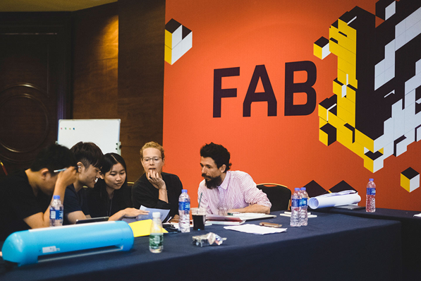
EXAMPLE YDSI – Making Sense
Co-creating technology for change with concerned communities
Making Sense Project Developed Through Fab Lab Collaboration
The Making Sense team members, Gui Seiz (IAAC), Emma Pareschi (Waag) and Mara Balestrini (IAAC) devised a workshop centered around critical design methods to guide the creative process, and engage participants, in imagining how participatory sensing tools and initiatives could help to address pressing environmental issues in Futureville, a fictional city. To achieve this goal, the was workshop comprised of three phases.

Slide 53
Exercise – Set Up Your Own Makerspace
You can create your own Makerspace at home or at school. It is about creating a community or class project workspace where people with common interests can come together. Often they revolve around topics in computers, digital design, science, AI etc.
As long as people can meet, socialise, discuss, learn and collaborate. These are great for learning groups providing hands on learning, helps with critical thinking skills and even boosts self-confidence.
Its about creating something out of nothing or very little and exploring your own interests that is at the core of makerspace.

Slide 54
Exercise - Set Up Your Own Makerspace
Allocate some time in your classroom to come together. Invite people to join you. Provide the objective. Start working on an idea (see Module 3). Decorate and equip a corner with all the equipment and resources, crafts and information you need. Have a file set up on a computer with all your ideas, information, research and suggestions.
Some of the skills that are learned in a makerspace pertain to electronics, 3d printing, 3D modeling, coding, robotics and even woodworking, Makerspaces are also fostering entrepreneurship and are being utilized as incubators and accelerators for business startups.
Examples of Educational Makerspaces

Slide 55
A Makerspace is
“a collision of art, technology, learning, and collaboration”
“A maker space is a place where students can gather to create, invent, tinker, explore and discover using a variety of tools and materials.”
Diana Rendina, Student
‘A space with materials for students to let their curiosity and imagination come to life. An informal, playful, atmosphere for learning to unfold. A space where making, rather than consuming is the focus. A space where trans-disciplinary learning, inquiry, risk-taking, thinking, crafting, tinkering, and wondering can blossom.” Ann Smart

Slide 56
European Level Support
Social Innovation Commission
The Social Innovation Commission has lots of resources and information focusing on providing support in;
Networking - help businesses across Europe to connect, learn from each other, and share experiences through the Social Innovation Community portal.
Competitions - every year they organise the European Social Innovation Competition to source and support new solutions to societal challenges, and thereby raise awareness about social innovation. Other European contests also support social innovators, such as the RegioStars Awards, and the Social Innovation Tournament.

Slide 57
European Level Support
Social Innovation Commission
Funding - they offer direct funding to support social innovation through the Employment and Social Innovation Programme, Horizon 2020, particularly under the SME Instrument which is open to social enterprises, or the Collective Awareness Platforms.
Ecosystems - we improve the conditions for social innovation and social enterprises in Europe, also to attract private investors. Learn about the Social Business Initiative and the Start-Up & Scale-Up Initiative.
Impact - we gather and disseminate evidence about the benefits of social innovation and methodologies for result measurement.

Slide 58
European Level Support
Social Innovation Commission
Incubation - support incubation structures for social innovation in Europe, through EU-wide networks of incubators.
Connect and stay in touch on Social innovation community, European Social Innovation Competition -
Further Reading
This is European social innovation
Empowering people, driving change – Social Innovation in the European Union (2MB)
Social innovation, a decade of change (BEPA) (2MB)

Slide 59
Case Studies
Young Digital Social Innovators
Techfugees, UK Empowering Displaced People With Technology; Developed through Collaboration
Goodbixbox, Macedonia What Social Entrepreneurs Need to Have in their Toolbox to Increase their Chances of Success
Lallab, France A collaborative environment with resources and tools supporting the freedom of every Muslim woman

Slide 60
Empowering Displaced People With Technology
EXAMPLE YDSI’s – Techfugees, UK
Developed through Collaboration From a Gripping Photo of the Lifeless 3 year old Syrian Boy, Aylan Kurdi
Techfugees was created in September 2015 following a call on Facebook from Mike Butcher, Editor-at-large of TechCrunch in Europe, in response to the picture of Aylan’s lifeless body on a Turkish beach. A few days later, 300 people were brought together in London for a first conference, followed by a hackathon. This experience was the beginning of our development of our Digital Social Innovation business Techfugees.
Josephine Goube, Co Founder & Executive Directory
Min Teo, Board Member and Founding Member
Little Aylan Kurdi (RIP)

Slide 61
EXAMPLE YDSI’s – Techfugees, UK
Empowering Displaced People With Technology
WE CO-CREATE TECH SOLUTIONS
We bring innovators, humanitarians, researchers & social entrepreneurs, both from refugee and local communities, together to create tech solutions together
Josephine Goube, Co Founder & Executive Directory
Min Teo, Board Member and Founding Member
WE COLLABORATE WORLDWIDE
We work as an open global platform thanks to a worldwide community of volunteers throughout the five continents and through homebuilt platforms such as Basefugees
WE ARE WORKING 99% ONLINE
We have developed a virtual open innovation methodology & deliver programmes in a remote fashion.

Slide 62
EXAMPLE YDSI – Goodbixbox
What Social Entrepreneurs Need to Have in their Toolbox to Increase their Chances of Success
Interview with social entrepreneur from Goodbizbox, Bistra Kumbaroska, Macedonia
‘A toolbox, as such, does not exist, but currently, our team is developing a simplified DIY toolkit, an online platform called goodbizbox, that can help entrepreneurs to discover and manage their impact through a 15 station, gamified process. Processes that will help “walking on high heels and backwards” might affect your way of thinking, your way of dealing with fear, your management style, your way of measuring impact, or simply, how to build a P&L (profit and loss statement) in a spreadsheet. The best way to get on board with those is to apply for a support program to help on your way: whether Impact Hub programs, Ashoka, SIA, Skoll, GSEN, or Innovation for Change network’.

Slide 63
EXAMPLE YDSI - Goodbizbox
Help entrepreneurs through gamification
Interview
Interview with social entrepreneur Bistra Kumbaroska, Macedonia
‘Have you ever had the feeling you want to do something to make this world a better place? Yes? Us too. That's why we started the project "goodbizbox", a name that holds a big purpose we hope to achieve with you and many others together’
​What Does Goodbizbox Stand For?
good meaning: regenerative, bountiful, fertile, attractive, profitable and wholesome
biz standing for: business, venture, start-up or any kind of system that creates, delivers and captures value
box meaning: frameworks, step-by-step toolkits, easy-to-use tips and tricks placed in a physical box

Slide 64
EXAMPLE YDSI – Lallab, France
Sarah Zouak, Co Founder & Director
Lallab is a feminist and anti-racist association whose goal is to make voices heard and to defend the rights of Muslim women who are at the heart of sexist, racist and Islamophobic oppressions. We are bringing a paradigm shift in the French anti-discrimination political system. We are shaping a world in which women freely choose their own paths of emancipation.
Our Vision Create a world in which each woman can fulfil herself without fear of being judged, discriminated against or abused whatever her identities.
Our Mission To produce an environment, resources and tools favouring the freedom of every Muslim woman to define her identities and her life course.
Lallab, Sarah Zouak, Co Founder & Director

Slide 65
EXAMPLE YDSI – Lallab, France
Sarah Zouak, Co Founder & Director
Discover Lallab’s Key Events and Tools
Currently +50,000 people affected by our Vision of Inclusive Feminism
+500 members belong to a caring community
+300 stories written by members to reclaim their stories

Slide 66
Next Module 5
How to Fund and Finance A Digital Social Innovation Idea; Different Ways to Access Funding and Finance
email
website

