Slide 1
Module 3
Digital Social Innovation
Using Design Thinking to Set Up Your Social Innovation Idea or Business

Slide 2
Overview of all 6 Modules
Module 1 Digital Social Innovation Introduction - the potential at the intersection of technology and new media
Module 2 Where are the opportunities for young people? Social issues solutions in health, democracy, consumption, money, transparency, and education
Module 3 Mastering and Implementing Design Thinking
Module 4 Driving Your Business Forward and Creating Partnerships with Purpose
Module 5 How to Finance and Fund Your Digital Social Innovation Idea
Module 6 Social Innovation Mission Marketing – Reaching Hearts and Minds
WELCOME
How to use these Modules! These Modules can be adapted, modified, shortened or combined however you think they will work best for you and your students learning. Please respect copyrights, branding and acknowledgement that these resources and materials were developed by Young Digital Social Innovators with the funding and support of the Erasmus+ European Commission.

Slide 3
Module: What you will learn?
What is Design Thinking and way and how you should apply Design Thinking to Your Social Innovation Idea
Design Thinking – THINK – INVENT - INNOVATE How to confirm the problem and create the innovative solution(s): introduction to Design Thinking and the Five Stages
Mastering and Implementing Design Thinking Design Thinking and the Collective Impact and how to meet unmet customer needs by putting them at the center of the problem
Overview

Slide 4
Module 3 Learning Objectives
Learn and apply Design Thinking principles to form the digital ultimate social innovation outcome, be that to improve existing processes, remove or reduce barriers that prevent successful implementation
Learn how to develop better solutions to social problems e.g. by adapting a human centered approach and making sure they are relevant to unique cultural contexts and specific situations.
Learn how to interpret the world and work with real people as design participants, safely take creative risks, learn from prototypes, and be agile and iterative. You will develop a stack of capabilities necessary for being “social innovation change agents”.

Slide 5
Design Thinking….
Is often referred to as ‘outside the box’ thinking, as people are attempting to develop new ways of thinking that do not abide by the dominant or more common problem-solving methods.
‘As an approach, design thinking taps into capacities we all have but that are overlooked by more conventional problem-solving practices. Not only does it focus on creating products and services that are human centered, but the process itself is also deeply human. Design thinking relies on our ability to be intuitive, to recognize patterns, to construct ideas that have emotional meaning as well as being functional, and to express ourselves in media other than words or symbols’.

Slide 6
How your project will benefit from using Design Thinking Techniques
.
Design Thinking is perfect for developing a social innovation idea because it allows high impact solutions to come to life. It specifically helps social entrepreneurs be more innovative, be able to differentiate themselves, bring their innovations to market faster.

Slide 7
Quick Reminder!!!
How digital social innovation can impact the future and do ‘good’ for everyone involved!
Nesta – The Innovation Foundation, UK
https://youtu.be/DSijSS7MKN4

Slide 8
Introduction to Design Thinking
Think – Invent - Innovate
Our world is changing more rapidly now than perhaps ever before, making staying ahead of the innovation curve even more critical. In this section, you will learn what is necessary to integrate the needs of people, the possibilities of technology, and the requirements for business success with design thinking, systematic inventive thinking, and strategy that will enable you to build products and services that drive your digital social innovation business forward.

Slide 9
Watch…
What is Design Thinking in Social Innovation Projects?
Generation TVET
https://www.youtube.com/watch?v=TPDLD35_hgE

Slide 10
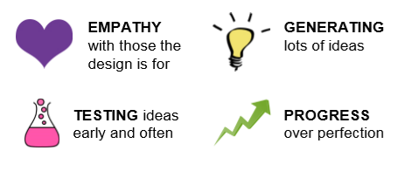
Design thinking is a way to generate possible ways to address complex problems.
It is about creating enjoyable, inspiring and quality products, services, experiences, or systems that work for those who use them.
Design thinking helps people explore the possibilities of what could be by bringing new things to life.
Designers begin with what is wanted: with the needs and wishes of the end users. To gain insight, they track the bugs & fixes people develop.
Design Thinking involves….
To put it simply….

Slide 11
Seeks to understand the user – it revolves around developing an understanding for the people we are designing the product or service for!
Helps us observe and develop empathy with the target user
Helps us to question the problem, question and challenge assumptions and question the implications
Redefines problems to identify alternative strategies and solutions suited to the human way
Solution based approach to solving social problems – through brainstorming sessions, hands on methods in prototyping and testing…
Also involves ongoing experimentation – sketching – prototyping – testing and trying out concepts and ideas…
What is so Special about Design Thinking?

Slide 12
Social Innovators can design their project applying human centered techniques – solving their problems in a creative and innovative way!
Design Thinking to refer to a specific set of procedures, techniques and methods used to unlock innovation” (Brown, cited in IDF, n.d)
T. and D. Kelley, call design thinking the “sweet spot of feasibility, viability and, desirability” (Kelley, 2014, p.19)
Design Thinking brings together what is desirable from a human point of view with what is technologically feasible and economically viable (Brown, 2009, p.3); and great innovative ideas happen at the intersection of the three (IDEO U, n.d.)
What is so Special about Design Thinking?

Slide 13
5 Phases to Design Thinking
Empathize, Define, Ideate, Prototype and Test—it important to understand that the 5 phases do not always have to be followed in a particular order. Look at them as ways to contribute to developing your innovative project rather than following a strict step by step process, mix them up, repeat them, whatever works…
The next section introduces the 5 Stages of Design Thinking…
Interaction Design Foundation
https://www.interaction-design.org/literature/article/5-stages-in-the-design-thinking-process

Slide 14
5 Phases to Design Thinking
Design Thinking tackles complex problems by:
1 Empathising: Understanding the human needs involved.
2 Defining: Re-framing and defining the problem in human-centric ways.
3 Ideating: Creating many ideas in ideation sessions.
4 Prototyping: Adopting a hands-on approach in prototyping.
5 Testing: Developing a prototype/solution to the problem.

Slide 15
Empathise
To help discover the problem by researching to gain an empathic understanding of the problem you are trying to solve. Types of research and the role they play e.g., desk research to identify what exists, interviews to talk to the person in need.
Define
The area you need to focus on by analyzing all the information gathered in stage one so you can clarify, define or reframe the core problem

Slide 16
Ideate
Develop potential solutions by generating lots of ideas through brainstorming activities to spark innovation and select the best ones
Prototype
Design brief with problem defined. Giving life to the ideas previously selected by making inexpensive and scaled down versions of the idea in order to investigate further what the solution is…
Test
To find the solutions that work. Evaluate the solution ideally with the people it is designed for in order to collect feedback that will help further redefine the solution

Slide 17
Mastering and Implementing Design Thinking
Where do I start?
The process puts unmet customer needs at the center of the problem, and every step brings you closer to solving the problem.
Design thinking is a powerful process of problem solving that starts with understanding unmet customer needs. When design thinking approaches are applied to business, the success rate for innovation improves greatly. The 5 Stage Process will let you reveal important information so can apply creativity, prototyping, testing then your final social innovation project. Get ready to get started on your idea and solution generation journey….

Slide 18
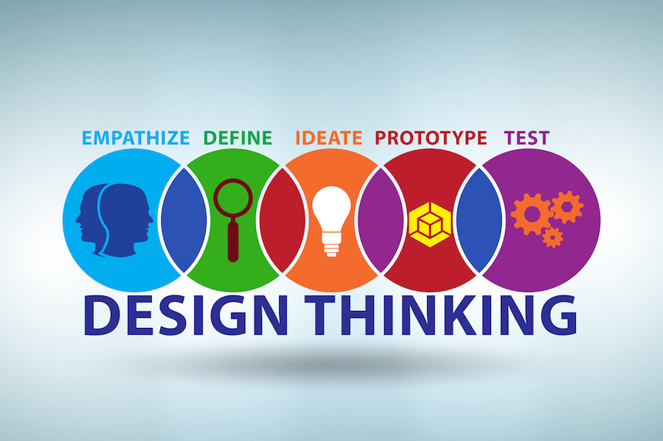
Empathise
Research Your Users' Needs
Here, you should gain an empathetic understanding of the problem you’re trying to solve, typically through user research. Empathy is crucial to a human-centered design process such as design thinking because it allows you to set aside your own assumptions about the world and gain real insight into users and their needs. This is where you question everything: the problem, the assumptions and consequences in order to get to the root causes of the initial problem.
Understand your users needs

Slide 19
Empathise
First Consider…..
What is existing and what is missing for my target audience? What is the best way to get the information I need to understand their needs? What are their existing challenges and barriers? Who am I empathizing with? How and when will I need to communicate?
You can use multiple different tools and templates e.g., questionnaire templates, research planning tips and tools, suitable research formats, suitable questions and pitch, scoping, how much information and time do you need. This is where you will understand who you need to target

Slide 20
Empathise - Exercise
SET UP AN INTERVIEW IN A COMFORTABLE PLACE Spend time with the people you are trying to help or provide a solution for and take notes
FIND OUT THEIR HOPES, FEARS…Ask them to tell their stories, what are their challenges, biggest problems, what are they frustrated about….
OBSERVE THEIR BEHAVIOURS, ask them why they are behaving the way they are – take notes
PUT IT ALTOGETHER Make sense of the information you gathered by putting it all together – in Stage 2 Define you will learn how to understand and interpret it better.
Before you do that consider the following slides first….
RESOURCE How to come up with your social innovation idea and define it

Slide 21
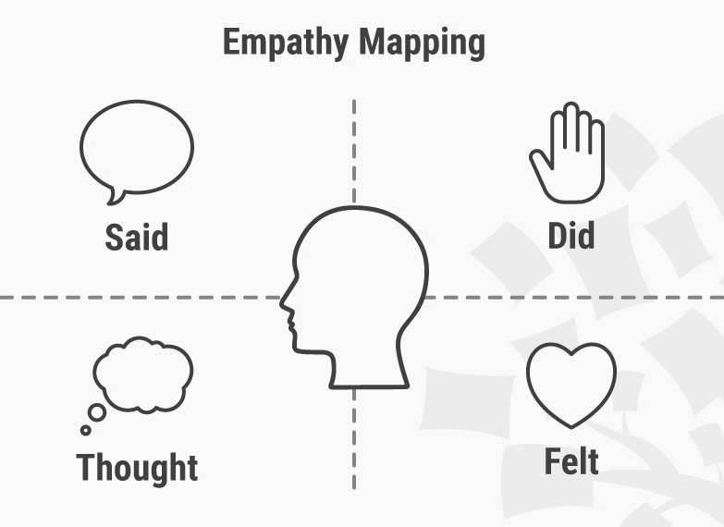
Empathise - Exercise
WHO WILL YOU INTERVIEW? Who is affected? Who is experiencing the problem? Where are they from? What is the age group(s)? What is their reason for being in the situation they are in?
WHAT IS THE PROBLEM? What are their struggles? What do they need? What are their pain points? What do you want to solve? What is the problem, the challenge? Be ready to discover other problems…
WHERE DOES IT HAPPEN? Where do they experience the problem? Is it online, offline or in a digital space? Who else is involved? What else is involved?
WHY DOES IT MATTER? Why is the problem worth solving? What will it do for the user? What will it do for you?

Slide 22
Empathise - Exercise
HELP YOUR AUDIENCE UNDERSTAND explain to them what you are doing and trying to solve, draft up a set of questions you need to answer, inform them that it is a discussion to allow for further interaction…
MAKE THEM FEL COMFORTABLE try to figure out what the audience needs (tea/coffee, circle setting…)?ensure they understand it is a confidential session so they can open up, you might introduce a couple of ice breakers so get to know each other….
Check out the next slide to help guide your questioning….

Slide 23
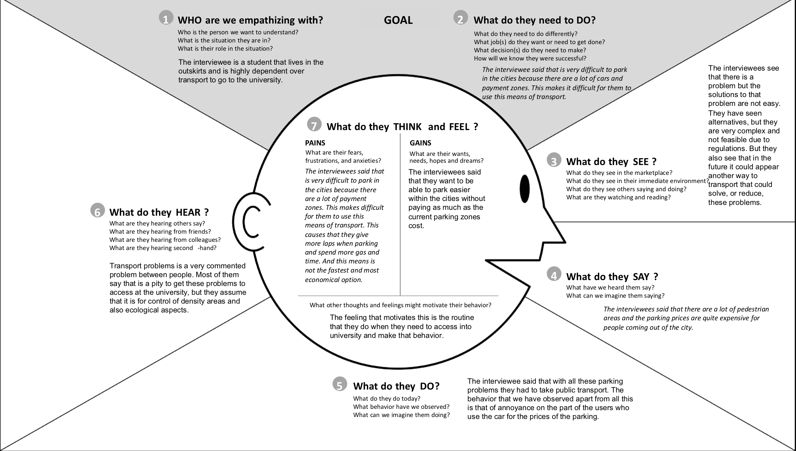
Empathy Map Canvas
Design Your Interview or Focus Group With Your User's Needs In Mind!
UX Booth Empathy Map
https://www.uxbooth.com/articles/empathy-mapping-a-guide-to-getting-inside-a-users-head/

Slide 24
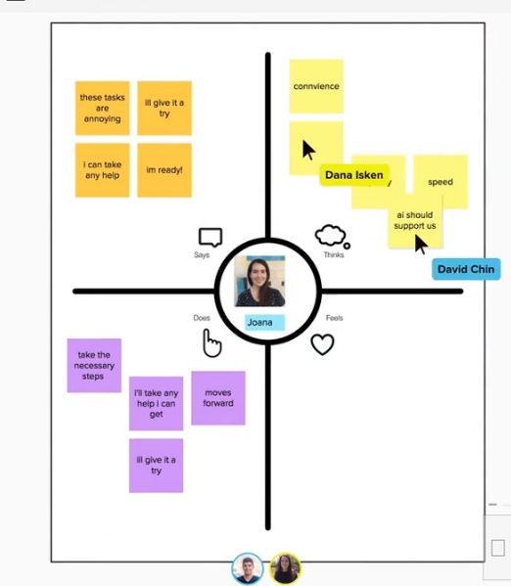
More Tools & Exercises Empathy Map Canvas
Design With Your User's Needs In Mind!
These tools will help you to develop a deep, shared understanding and empathy for people, an Empathy Map is a tool helps describe aspects of the user's experience, needs and pain points. The template will allow you to quickly understand your users’ experience and mindset.
Get started with the Empathy Map Tool to understand to develop a deep shared understanding and empathy for your users.
Use Empathy Diamond Tool to understand your audiences motivations by graphing their key facets
Try the Customer Discovery Canvas to create a shared understanding of customer aspirations and priorities to identify opportunities and determine the next steps

Slide 25
The Real Social Action Heroes Put Empathy First
WEvolution
Eleanor says her love affair started for Wevolution in 2016. The social innovation model is amazing and has been life-enhancing for the 8 million women around the world who have joined in.
WEvolution, led by the inspiring Eleanor Campbell, which promotes self-reliant groups. These small, self-starting, groups bring together 6–10 women weekly to save money (think £1 a week) communally and use it to start small enterprises (crafting, cooking, cleaning etc,). In doing so, women find connection and support, and create a route to earn money..

Slide 26
Shared Lives Plus supports adults with additional needs like learning difficulties or dementia to live with a family rather than in residential care. This model saves the state millions each year, but more importantly those who go to live with one of the 12,000 families report much better outcomes – like feeling secure and making friends.
GoodSAM, an app that alerts nearby volunteer first aid responders to emergencies alongside an ambulance crew. Volunteers can start CPR whilst waiting for the ambulance to cut through the traffic, as well as relay video feeds on scene back to the 999 dispatch control room. 1.3 million now give their time as volunteers on the platform, meaning lives saved every week, and we supported the Government to use it to mobilise the first 750,000 COVID-19 volunteers.
The Covid Tech Handbook, Connection Coalition, Fareshare, The Cares Family and so many others are more who responded so quickly during the first wave of COVID-19 to support communities directly, and make sure the best ideas spread fast.
More Real Social Action Heroes with Empathy at the Centre of their Ideas
COVID-19 Response Ideas

Slide 27
EXAMPLE YDSI
Care Across
Thanos Kosmidis, UK
A digital health start up focusing on the wellbeing of cancer patients.
Care Across is a digital health start-up focusing on cancer. Their vision is to provide patients and caregivers with the best means to help them fight cancer beyond their hospital, from diagnosis to long-term care. They support people affected by cancer, through credible information, useful tools, psychological support and expert advice.

Slide 28
Interview with Young Digital Social Innovator
LINK TO FULL INTERVIEW
Q1 How did you come up with the idea?
I realised that there is a very wide gap in addressing the needs of cancer patients, both in terms of reliable information and support. I noticed how patients were increasingly looking for information and resources online, and they often found it difficult to identify the right sources. They also faced great challenges in understanding the material they ended up finding. We conducted a systematic analysis* of the current situation’ involving both experts and ordinary people. Following that, a large number of interviews with experts and patients (and patient representatives) took place in order to keep on refining the concept.
*Systematic Analysis gathering all available information by researching and using clearly defined ways to get the answers we needed to a particular question.

Slide 29
Define
Put Your ‘Users' Needs and Problems in One Statement or Sentence
It’s time to put all the information together that you gathered during the Empathize stage. In this step you will define the problem. You will analyze what you observed and learned and put it altogether in a way that you can understand your problem in one sentence or statement. You do this by developing problem statements and finally coming up with one. You can also create personas to make sure you are using a human-centred approach to prepare for Stage 3 ideation.
What is the Problem?

Slide 30
Define - What are Problem Statements?
An integral part of the Design Thinking process defining a meaningful and actionable problem statement. In other words what exact problem are you solving?
This is often the hardest bit of the Design Thinking Process, also called the ‘design challenge’…
Defining your problem will greatly improve your Design Thinking process and result. Why? A great definition of your problem statement will guide you and kick start the ideation process in the right direction.
It will bring about clarity and focus to the design space.
If you don’t pay enough attention to defining your problem, you will work like a person stumbling in the dark.
See Full Resource of Ways to Define Your Problem Statement

Slide 31
Define - First You Need to Understand Analysis and Synthesis!
Design Thinking Analysis is about breaking down difficult concepts and problems into smaller, easier-to-understand parts. For example during the first stage of the Design Thinking process, the Empathise stage, you discovered and observe information to understand your users better.
Design Thinking Synthesis, involves creatively putting the puzzle together to form whole ideas. In other words we organise, interpret, and make sense of the data and information we have gathered to create a problem statement.
To clarify the first analysis takes place during the Empathise Stage 1 and first synthesis takes place during the Define Stage 2, they do not only happen in these stages but often happen throughout all stages of the Design Thinking process. Design thinkers often analyse a situation before combining new insights, and then analyse their synthesised findings once more to create a more detailed syntheses.

Slide 32
Define - A Good Problem Statement Should be…
Human-centered. Where decide on your problem statement to your users or target audience, needs and what you discovered about them in the Empathise phase. The problem statement should be about the people the you are trying to help, not only about the technology, making money or what the product or service will look like.
Broad enough for creative freedom. This means don’t focus too much on a specific way to apply your solution. The problem statement should also not list technical requirements because this will restrict you and stop you from exploring areas that might bring unexpected value and discoveries to your solution.
Narrow enough to make it manageable. It should not be too broad or general, needs to be specific enough so someone understands it in one sentence. It should be clear to what the project is and its purpose so that it is easily manageable.

Slide 33
Problem Statements
Put Your ‘Users' Needs and Problems in One Statement or Sentence
First start thinking….
What is the problem or pain you want to address?
What exactly do the users need? What are they saying?
Any key points and information discovered?
What is preventing them from solving these problems? Where are their roadblocks?
What do they say, think and feel?
Problem Statements

Slide 34
Define Your Problem Exercise Evaluation your interview or discussion group feedback…
Draw a circle in the middle of an A4 Sheet of paper and write down what you think is the main problem.
Create arrows with responses addressing the following questions.
Go through each responses from your interview or discussion group and and write down the answers to the following questions in the next slide….

Slide 35
Define Your Problem Exercise Evaluation your interview or discussion group feedback…
Write down the top 5 problems and possible solutions?
How do they feel? What would make them feel happy, relieved, satisfied?
What do you need to change? How are you going to change it?
What was interesting? What is missing? What are the opportunities?
Pick the main points and problem and insert them in the circle, these are the words that you will consider for your problem statement

Slide 36
Define Your Problem Exercise Evaluation your interview or discussion group feedback…
Summarise your findings making them clear and short
Highlight the main problem points and put in circle in the middle of your page, these are the words that you will consider for your problem statement
What is Your Mission or Problem? Next narrow your findings again down to one main problem or statement sentence…think of it like a mission statement!

Slide 37
EXAMPLE YDSI - ROOTED
JoAnna Haugen, Slovenia
Solutions platform at the intersection of
sustainable tourism, storytelling,
and social impact.
My mission through Rooted is to responsibly document, support, celebrate, and share sustainable travel-related initiatives that prioritize local communities and the planet — and to help others do the same..’

Slide 38
Interview with Young Digital Social Innovator
JoAnna Haugen, Rooted
Full Interview
Q1 How did you come up with the idea?
My own observations and experiences were the impetus behind Rooted. More than 15 years ago, I served as a U.S. Peace Corps volunteer in rural Kenya, and on numerous occasions, I saw the people in my own village come up with creative solutions to the problems they encountered. The idea that solutions born at the local level are often the best ones has always stuck with me. Yet most people don’t know about these creative, locally born solutions to some of the world’s most pressing issues because they don’t have exposure, big marketing budgets, etc. The goal is to solve the problem.

Slide 39
Interview with Young Digital Social Innovator
JoAnna Haugen, Rooted
Full Interview
Q2 What is the one piece of advice you can give an aspiring social entrepreneur?
Hiring a business coach helped me find clarity with my idea was essential. I knew what I wanted to do and say, but I didn’t know-how. She has been instrumental in helping me prioritize, set goals, and holding me accountable as I develop Rooted. If you have the financial means and a great idea but don’t know where to start, I suggest hiring a business coach.

Slide 40
Ideate
Ideate
Challenge What You Think is True or the Reason and Create Ideas!
Now, you’re ready to generate ideas. The strong knowledge and understanding from the first two phases means you can start to “think outside the box”, look for alternative ways to view the problem and identify innovative solutions to the problem statement you’ve created. Brainstorming is particularly useful here…
What is your solution?

Slide 41
You should already be thinking of ideas at this stage, you have grown to understand your users and their needs (Stage 1 Empathise), you have studied and organised the main findings and come up with a human cantered problem statement or mission (Stage 2 Define)
Now at Stage 3 Ideate you can start to ‘think outside the box’ to identify new solutions to the problem statement you’ve created, and you can start to look at different ways of looking at the problem. There are hundreds of Ideation techniques such as Brainstorm, Brainwrite, Worst Possible Idea, and SCAMPER. Brainstorm and Worst Possible Idea sessions to stimulate free thinking and to learn more about the problem and the solutions.
It is important to get as many ideas or problem solutions as possible at the beginning of the Ideation phase. You should pick some other Ideation techniques by the end of the Ideation phase to help you investigate and test your ideas so you can find the best way to either solve a problem or provide some answers at the very least.
Ideate
Challenge What You Think is True or the Reason and Create Ideas!

Slide 42
Ideate
Challenge What You Think is True or the Reason and Create Ideas!
First start thinking…
What exactly is the problem you are trying to solve?
What are the potential solutions or ideas that can solve the problem?
Have you got all perspectives, ideas and insights gathered?
How will your solution ideas address the needs of the people who will consume your innovative product or service?
What are you solving?

Slide 43
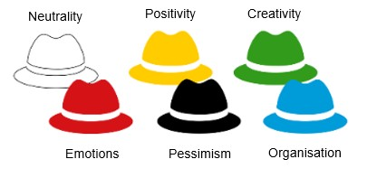
Ideas Exercise
Six Thinking Hats
6 Thinking Hats help you or a group to come up with ideas from all angles bringing you to many and finally one idea to your solution
Brainstorming with Hats!
White Thinking Hat – considers information requirements (facts, figures…) without judgement…
Yellow Thinking Hat – considers positive reasons – what is good, useful, correct…
Green Thinking Hat – considers colour, design, ideas, what it will look like, how to do or approach it…

Slide 44
Ideas Exercise
Six Thinking Hats
Red Thinking Hat – considers emotions, feelings and impressions without judgement…
Black Thinking Hat – considers negative things, problems, what is wrong, what is incorrect…
Blue Thinking Hat – considers how you think, the pattern you follow, and makes sure the other hats are used correctly

Slide 45
Ideas Exercise
Six Thinking Hats
DISCUSSION Go through each of the hats as a group, discuss and write down your ideas on post its and stick them up for everyone to see under a coloured hat so the information is organised
SUMMARISE YOUR FINDINGS using the blue hat, in other words ‘thinking about your thoughts’, make your ideas clear and short
HIGHLIGHT THE MAIN IDEAS by identifying the main issues, tensions and identify the steps of the problem with the ideas that could provide the best solution
WHAT IS YOUR MAIN IDEA(S)? Next narrow your ideas again down to one main idea or solution. It is ok to have a few ideas at this stage but start with one for the prototype stage…

Slide 46
EXAMPLE YDSI, Progressive Careers
Gary Fawdrey, UK
‘The Creation of Digital Social
Impact in Unemployment’
Progressive Careers has set as a mission to address the humanitarian crisis created by unemployment. ‘Progressive Careers is a support network aiming to help people transition into the social impact sector and make more than money.’
Gary Fawdrey.

Slide 47
Interview with Young Digital Social Innovator
Gary Fawdrey
Progressive Careers, UK
Full Interview
Q1 How did you come up with the idea?
I was lucky enough to secure a place on a social impact graduate scheme, and was placed in a social impact start-up organisation that facilitated collaboration between multiple charities. Through this experience I learnt about many different opportunities in the sector, and realised that there are lots of potential social impact careers. I decided to create what I wished I had had access to myself, a one-stop shop for all the information I needed. I am also passionate about the importance and power of mentoring, and thus decided 1-to-1 advice from people who had already broken into the sector would be highly valuable to those just starting out.

Slide 48
Prototype
Start to Create Solutions
This is the experiment and trying it out phase. The aim is to identify the best possible solution for each problem found. You or your team should produce some inexpensive, small size versions of the product (or specific parts found within the product) to investigate the ideas you’ve generated. This could involve simply paper prototyping.
Bring your idea to life
Image: Innovation Training

Slide 49
You or your team will now investigate the problems solutions you have revealed by producing a couple of inexpensive, small sized versions of the product (or some features), or service.
You can share and test the prototypes in your team, with other teams or departments, or on a small group of people outside the design team. Possibly the people you interviewed – they will after all be the end users!
The aim here is to identify the best possible solution to the problem(s) you have identified during the first 3 stages (1 Emphasise, 2 Problem Statement and 3 Ideas). The solutions or prototypes one by one are investigated and either accepted, improved or checked again, or rejected based on what the ‘users’ have said or experienced.
By the end of this stage, you will have a better idea of what limits your idea (product or service), the problems with your design will be revealed, you will have a clearer view of how real users would behave, think, and feel when interacting with the end product.
Prototype
Start to Create Solutions
Full Resource

Slide 50
Prototype
Start to Create Solutions
First start thinking….
What will it look like?
What does it need? What does it not need?
How do you think your users will react to it (will it fit their needs)?
What is the most effective, easiest way for your users to use your service or product?
What do you need to make it work especially in the testing phase?
Do you need to build a series of variations?
Improve and modify

Slide 51
Prototype Exercise
Paper Prototyping
Paper prototyping is where you create a paper representation of digital products, tangible products or services to help you realise if your idea will work. Draw sketches or change or modify printed designs or map it out and study the users reactions to your idea. It is also great for brain storming!
CREATIVITY WITH LOADS OF COLOUR AND STATIONARY you will need, pens, pencils, markers, paper, card, Post-its, scissors, tape, glue, rulers and suitable stencils. About €10 is typically enough to cover this. You can use graph paper to help guide ideas. Colored paper is great for representing buttons.
Full Resource to Paper Prototyping

Slide 52
Paper Prototyping
Get building – Just go ahead and see where you end up. As you get your ideas down on paper, you can think about them clearer. Later, you can think about improving them. Make one sketch per page, it can be one idea or have a part of the idea. This is so you can move the pages around if you need to.
Move quickly – If you spend too long making your prototype, you’ll get attached to it. Don’t waste time erasing: You want to get ideas down rather than revise them and potentially miss insights from the raw version.
Remember what to test – Build with that reason or problem front of mind, but stay aware of other factors.
Prototype Apps & Tools – Later you can use some great drawing and design Apps to display your content better.
Remember the users – As you’ll test your prototype against users’ behaviors and needs, consider their expectations as you build.
Full Resource to Paper Prototyping

Slide 53
Prototype Exercise
Paper Prototyping – Other Tips & Ideas
You can get post its and develop the stages of your service, move them around, sort them…This approach makes your prototype development flexible
You can start with a rough sketch of your ideas, this may take a couple of takes – remove what doesn’t work, keep what works. This is a fantastic way to prepare for a more expensive prototype
Everyone should get involved in the development bit – get creative, get drawing, cutting, pasting and get it all down on paper
Full Resource to Paper Prototyping

Slide 54
Test
Test
Try Your Solutions Out
Testers should rigorously test the prototypes and be completely honest with their responses. Although this is the final phase, design thinking is repetitive: Teams often use the results to modify or fix one or more further problems. So, you can return to any of the previous stages to make further changes, modifications, alterations and refinements – to find or rule out alternative solutions.
Does your idea work

Slide 55
Test
Try Your Solutions Out
Full Resource
The next logical stage is the official user testing (you can use the same group you used in the Prototype Stage
This should be carried out in a flexible way and in no particular order. For example different groups within the design may try out more than one stage at the same time, or the design team may collect information and prototype during the entire project so they can bring their ideas to life and visualise the problem solutions.
Also, results from the testing phase could reveal some more findings and understanding about users and provide even better solutions or ideas, which in turn may lead to another brainstorming session (Ideate) or the development of new prototypes (Prototype).

Slide 56
Test
Try Your Solutions Out
First start thinking…
What is the evidence to prove that this will work?
Do you need to do multiple tests with different people?
Do you have user approval that their problem is being solved?
Listen to your users

Slide 57
Test
Paper Prototyping
Paper prototyping is where you create a paper representation of digital products, tangible products or services to help you realise if your idea will work. Draw sketches or change or modify printed designs or map it out and study the users reactions to your idea. It is also great for brain storming!
CREATIVITY WITH LOADS OF COLOUR AND STATIONARY you will need, pens, pencils, markers, paper, card, Post-its, scissors, tape, glue, rulers and suitable stencils. About €10 is typically enough to cover this. You can use graph paper to help guide ideas. Colored paper is great for representing buttons.
Full Resource to Paper Prototyping

Slide 58
EXAMPLE YDSI Touchpoints
Fabienne Colling, Luxembourg
NGO helping refugees in Luxembourg to pave their way to employment.
Touchpoints helps who come to Luxembourg as refugees to learn how to set up their own business. You guide them through administrative work, train them and finally put them in contact with a potential employer.
.

Slide 59
Interview with Young Digital Social Innovator
Full Interview
Q1 How do you empathise with your users?
In my opinion, to be called an entrepreneur, you must work with your users; they are after all the people who need the service, get it and will hopefully pay for it, in whatever way. It does not have to be the same person. For me, this is the essence of an entrepreneurial model and designing and developing your idea. If you do not deliver what your users you will not get paid. You can add a social impact layer, by caring about who your employees too, who you are serving, how you are serving, the problem you are solving etc.

Slide 60
Design Thinking at its Best…
Design Thinking should not be seen as fixed or inflexible approach to design; the different stages showed you different activities that are typically tried out. In order to gain the best and most informative information for your particular project, these stages might be switched, carried out together and repeated several times in order to come to the best solution and idea. Most importantly help you zero in on the best possible solutions.
What is also important is that you get as much knowledge and understanding from the users from the beginning and throughout the design stages to get the best knowledge and feedback. This means you can define your problem better based on their input and not on your assumptions.
Design Thinking creates an unending loop of design to help you develop the best possible solutions, identify the users and their needs and help you develop innovative social innovation solutions to the problems they face…

Slide 61
Next Module 4
How to set up a digital social innovation project or business
WHAT YOU NEED TO DO TO DRIVE YOUR PROJECT FORWARD
email
website

